Slide 1
Publisher-Driven Preprints
Louise Page
Publisher, PLOS
  June 19, 2017

Slide 2
PLOS and Preprints
Accelerate Progress with Early Sharing
PLOS has long supported authors who wish to share their work early and receive feedback before formal peer review
Posting a research article to a preprint server has never impacted consideration of the manuscript at any PLOS journal

Slide 3










Inspired by arXiv.org
Only 2% of published biomedical content is posted as a preprint annually
1991 1.27M
1991 621K
2016 104
2017 76
TBC
0
2017 4K
2013 12K
2017 12
2017 134
2013 3K
2016 1.1K
2016 500
Preprints

Slide 4
What role can a publisher play?

Slide 5
Add Preprints to the Publishing Workflow
Boost adoption by automatically directing submissions to preprint servers
Set and adopt content standards for journal submission for re-use as preprints and other journals/publishers
Channel vast experience reviewing content at scale for responsible posting
Adopt interoperable technical standards to facilitate advances in manuscript transfers, downstream, archiving, indexing
Advocate and educate the community

Slide 6
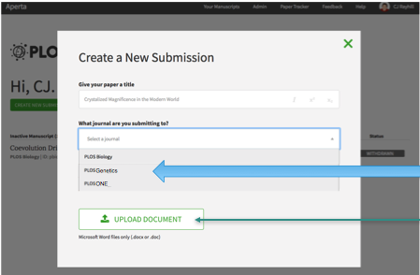
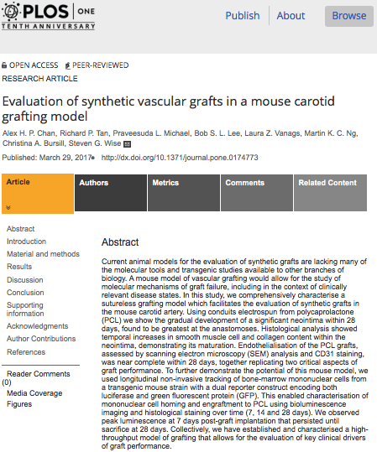
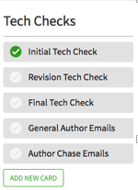

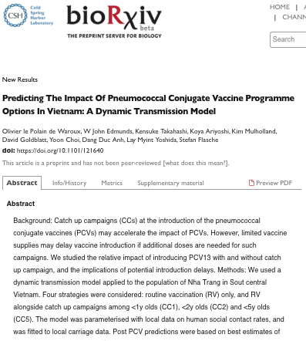



Publisher Driven Preprints Model
Versions / Revisions
Preprint display
STANDARD journal submission interface
STANDARD set of screening checks
Pass
Screening
AUTHOR
Preprint?
Assign DOI
Yes!
1 – 7 DAYS
Commenting
Full text
Indexing
Badging
Alerts
Downstream
Collections
Revisions
TRANSFER via API
DOI matchup with preprint DOI
Author chooses Publisher
TRANSFER via API
Peer Review
Publication Decision
Journal Publication
90 – 360 DAYS (3 – 12 MONTHS)
Review preprint comments
Shortcut publishing checks with preprint checks

Slide 7
Additional Added Benefits
Save author time
  One submission can be a preprint and an article
  Articles can be transferred to other journals through standard manuscript transfer protocols
Add “conversations” to the record
  Include preprint checks, open reviews, comments
Save publisher time
  Avoid duplication of effort
  Speed decision through transparency

Slide 8
PLOS Roadmap
Standardize all submissions through Aperta
Responsibly screen for preprint posting
  Automated checks through a combination of AI technology, similarity check, and taxonomic classification to flag high-risk
  Author affirmations to extract unsuitable content
  Manual check and decision
  Streamline and adjust along the way
CC-BY for maximum accessibility and reproducibility
Badging to clearly identify what’s been checked
Transfer to major manuscript systems

Slide 9
Look Ahead
Extend publishing standards to preprints
  Formats, indexing, DOIs, archiving, preservation
  Recognition and credit
Experiment with new assessment models
Disaggregate cost of publishing
  How can we make it cheaper? Faster? Better?
Explore sustainability
Increased advocacy
Greater collaboration and interoperability

Slide 10
Thank you

