Slide 1


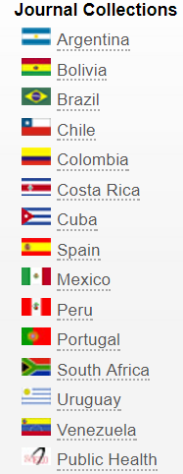
ASAPbio Meeting: The Evolving Preprint Ecosystem, 19 July 2017, Cambridge, Ma
Abel L Packer, Director of SciELO / FAPESP Program
ASAPBio is the reference for SciELO Preprints
SciELO 20 Years 26-28 September 2018
announced in February 22th 2017
regular operation from July 2018 as a collection in SciELO Network
today: 15 national collections: 12 LATAM, Portugal, Spain and South Africa 1 global on Public Health
~ 1k journals, ~50k arts/year, total 600k, ~1mm downloads/day
~ 80k preprints / year in 3-5 years, ~ 11-15% biology
objectives – advancement of research, improvement of nationally edited journals
strengthening of communication infrastructure and capacities
characteristics – best for many disciplines and research topics, multilinguism,
recognized alternative to prestige journals, learning to publish …

Slide 2
SciELO Model evolution – 20 years – running digital publication
2017-18: open science
preprint : OSF
authoring : Authorea, Texture
SciELO
research data : Figshare, …
SciELO
journal
2013: improving quality
journal
Word or Latex
XML JATS
HTML, PDF ePDF, ePUB
preprint
author
author
online manuscript services
1998 2012
2013 2017
2018 -----
continuous publication
1998 2012
2013 2017
2018 -----
broaden interoperability
1998: building up
metapublisher common platform research infrastructure
indexing, publication, interoperability
aggregation

Slide 3

Development, challenges and expectations
integral part of scholarly communication
research community centered governance
standards, key tools and cms as public common goods
journal’s active [new] roles, services to authors,….
quality control – at manuscript and server levels
SciELO expects / depends on ASAPBio to lead a global collective and research centered open solutions to preprint development
Thank you !

