Slide 1
Preprints and Other Interim Research Products NIH perspectives
Neil Thakur
Office of Extramural Research
National Institutes of Health
July 19, 2017
Boston

Slide 2
Interim Research Products
Broad definition (to avoid many small rules): Complete, public research products that are not final
Preprints are complete and public drafts of scientific documents. Arguably speeds dissemination, establishes priority, generates feedback, and may reduce publication bias.
Preregistering a protocol is publicly declaring key elements of a research project in advance. May reduce biases like p-hacking.

Slide 3
NIH’s interest: Stable infrastructure to advance science
Integrity
Open (accessible, impactful, egalitarian)
Preserved and reliable (versioning, linkages, metadata)
Encourage responsible standards and beneficial innovation
Allow disciplines to adopt at their own pace
Innovation can increase rigor and dissemination
Prevent bad practices from taking root
Ensure more preprints= better science

Slide 4
Integrity through standards and best practices
Citation format standards: DOI, list object type (e.g. Preprint, protocol)
Example: Bar DZ, Atkatsh K, Tavarez U, Erdos MR, Gruenbaum Y, Collins FS. Biotinylation by antibody recognition- A novel method for proximity labeling. BioRxiv 069187 [Preprint]. 2016 [cited 2017 Jan 12]. Available from: https://doi.org/10.1101/069187.
To cite preprints arising from NIH awards DOI Recommend CC-BY license Statement: not peer-reviewed Acknowledge funding Declare competing interests | Repository best practices FAIR principles (Findable, Accessible, Interoperable, Reusable) Open metadata Machine accessible and readable Transparent policies Versioning links to published version tracks key changes Permanent/archival plan
https://grants.nih.gov/grants/guide/notice-files/NOT-OD-17-050.html

Slide 5
Considerations for a central service
Allowable under federal rules
General principles
Does not limit innovation or competition
Open participation
Publicly accountable
Opportunities for evaluation and improvement
Align with NIH/NLM goals and operations
Many of these concepts described in the ASAPbio RFA

Slide 6
Infrastructure: Support multiple repositories for multiple disciplines
A central service that will …
Support integrity for all affiliated repositories
Complements and strengthens multiple repositories (disciplinary, publisher, institutional)
Ensure adherence to NIH policies
Ensure standards and promote advances in best practices:
e.g., competing interests, plagiarism, rigor, misconduct, JATS, CC-BY license, open metadata, APIs/machine accessibility, discovery/push tools, indexing, tagging, etc.

Slide 7
Infrastructure: Support multiple repositories for multiple disciplines
A central service that will …
Support innovation in the quality and impact of preprints
e.g., Commenting/community evaluation, metrics, text-mining
Reflect the interests of the scientific community
A place where the community can explore tagging, linking, innovation, etc.
Accountable stewardship of resources and science

Slide 8
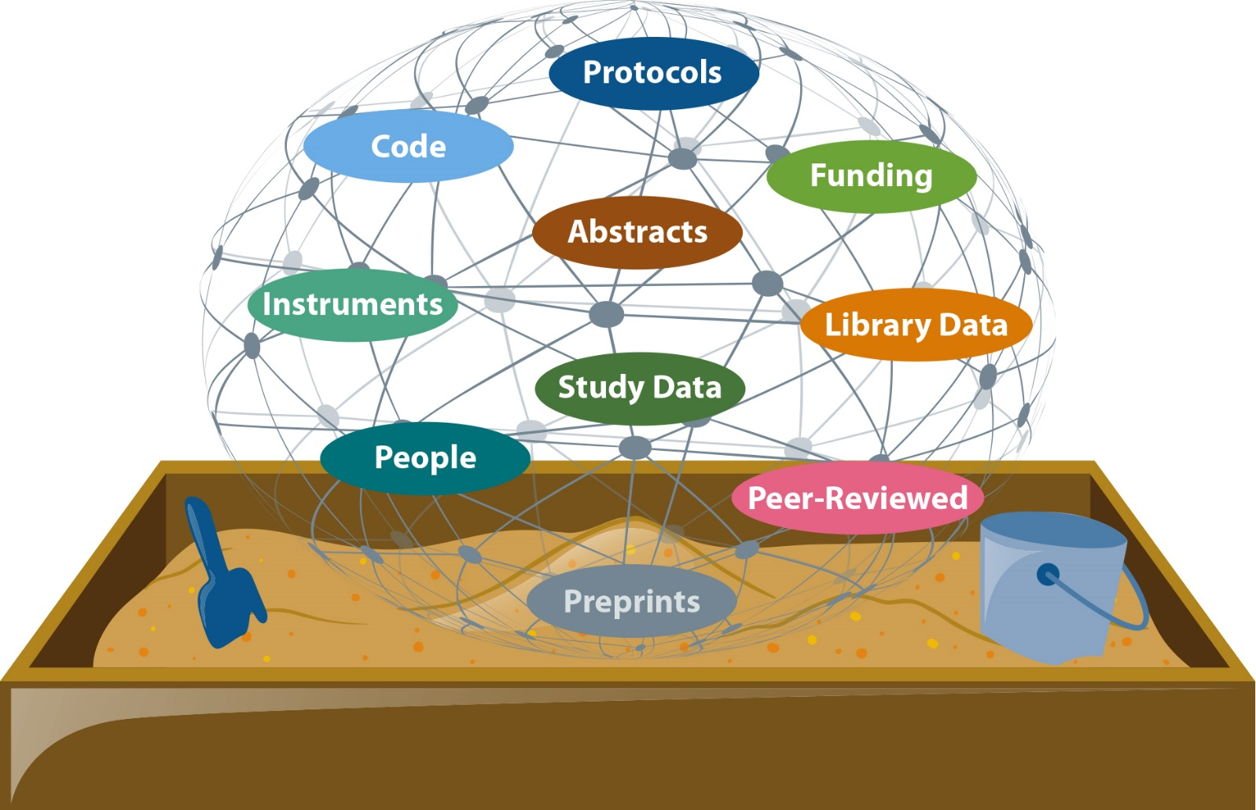
Infrastructure: Support multiple repositories for multiple disciplines
A preprint central service that will interconnect repositories and objects to solve problems
Future of science dissemination
Enhance access to all research products
Manage increased volume and complexity
Incentivize great science
Use products to solve problems
Accomplished through public-private partnerships

