Slide 1
Case for a preprints index

Slide 2
1. Scientists search multiple sources

Slide 3
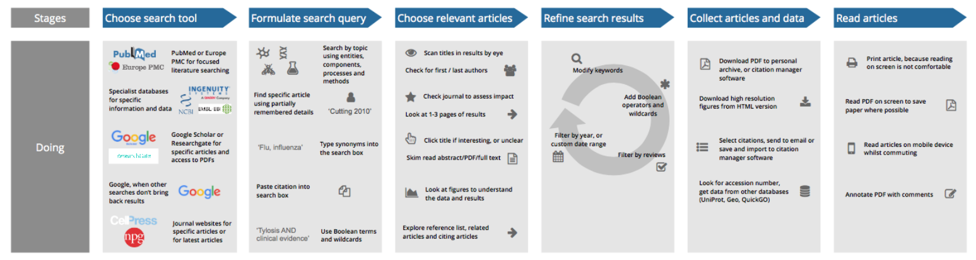
How life sciences researchers search for academic literature
https://figshare.com/articles/Europe_PMC_Literature_Search_User_Research_Report/4789744

Slide 4
2. The collection is (re)used.

Slide 5
15-20,000 papers per year mention PubMed
Enables writing of systematic reviews, QA and reproducibility, deep learning, algorithm development
A Case Study on Sepsis Using PubMed and Deep Learning for Ontology Learning
Important Difference to Infer Changes in Health Related Quality of Life - A Systematic Review.
The quality of the reported sample size calculations in randomized controlled trials indexed in PubMed.
Characterization of the mechanism of drug-drug interactions from PubMed using MeSH terms.

Slide 6
3. Use cases that rely on good metadata.

Slide 7

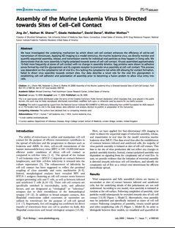
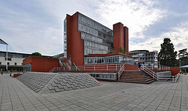
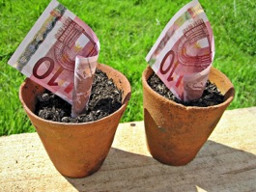
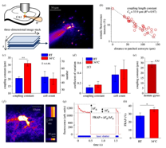
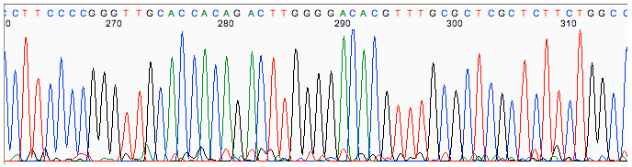
Integrated research, impact assessment, compliance monitoring
Articles
People
Institutions
Reused from: seier+seier, Flickr
Data
Reused from: Images Money, Flickr
Funders

Slide 8
4. Driving development and adoption of standards

Slide 9
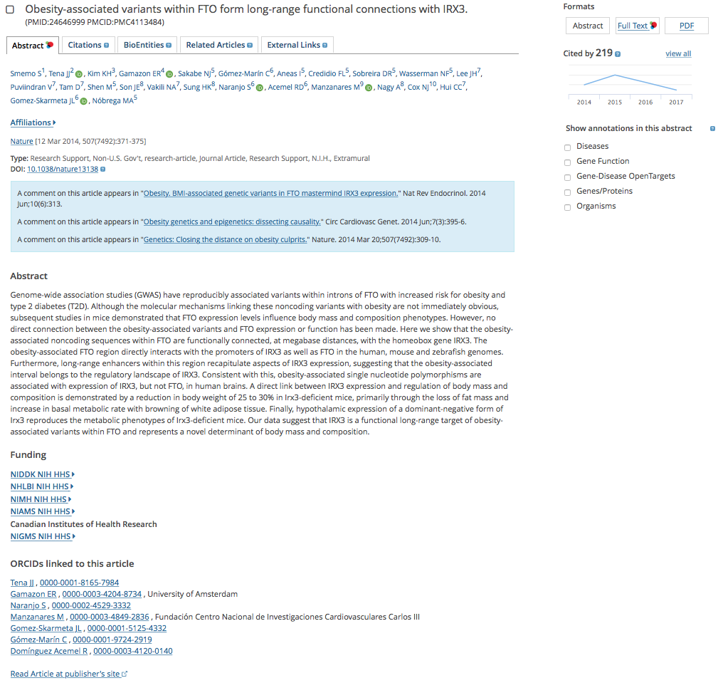
Metadata standards are not static
ORCIDs
Article types
Identifiers for funders, institutions, reagents
Data citation
Author roles
Versions management

Slide 10
5. Community-driven resources save time and meet community needs

Slide 11
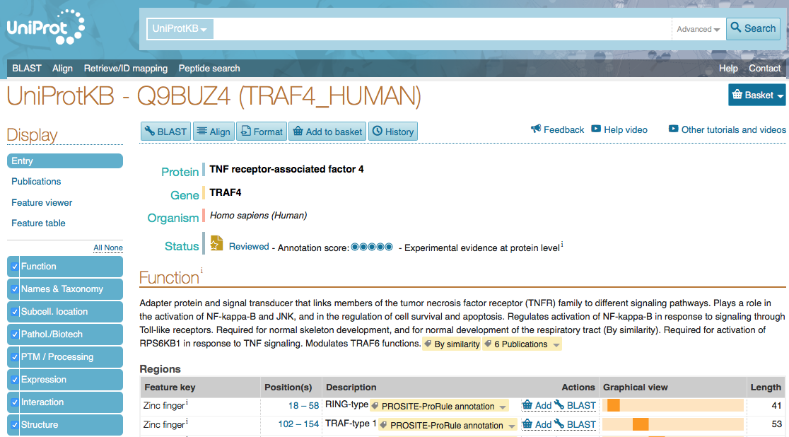
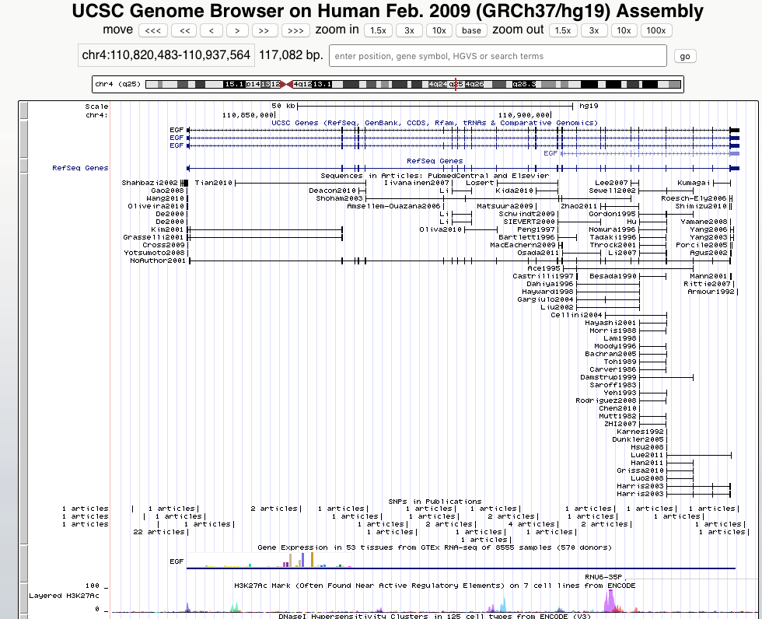
Scaling the efforts of a few

