Slide 1
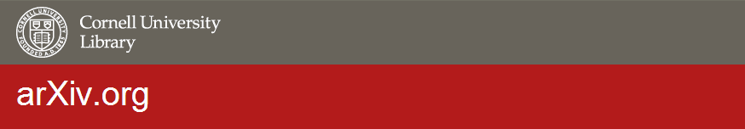
Principles and Best Practices for Preprints
Oya Y. Rieger
arXiv Program Director
Associate University Librarian
oyr@cornell.edu

Slide 2
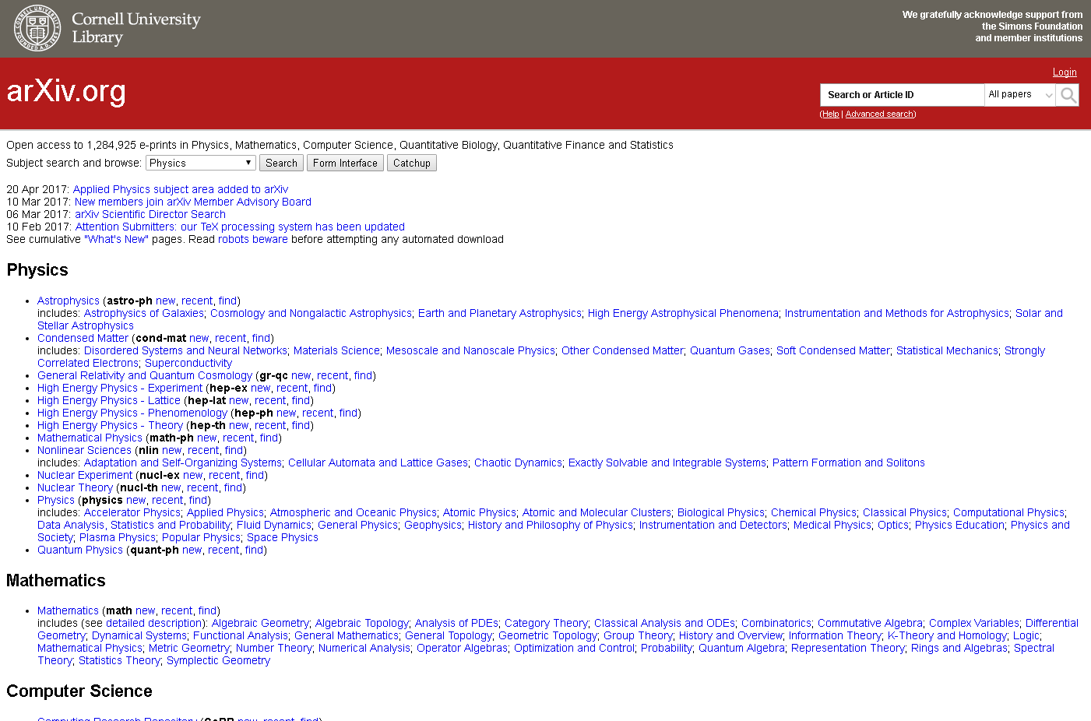
https://arxiv.org/
Notes:
arXiv.org is acknowledged as one of the most successful open-access preprint repositories and has transformed scholarly communication in multiple fields of physics and plays an increasingly prominent role in mathematics, computer science, quantitative biology, quantitative finance, and statistics. Using the 25th anniversary of arXiv as an important milestone, during the last year, the arXiv team at the Cornell University Library (CUL) has engaged in a series of vision-setting activities to assess the service from various perspectives.

Slide 3
Sustainability:
maintaining ecological balance of scientific communication
ability to secure resources needed to protect and enhance the value of preprint services based on the needs of the user community
meeting the needs of the present preprint users without compromising the ability of future opportunities

Slide 4
Open and Scalable Repository Architecture
Discovery, Access, Preservation
Curatorial Policies & Quality Control
Interoperability with Related Systems
Epistemological Cultures & Workflows
Business Strategies & Financial Stability
Governance & Principles
SUSTAINABILITY
Collaboration and Networking
SOURCE: Oya Y. Rieger. Sustainability: Scholarly Repository as an Enterprise. Bulletin of the American Society for Information Science and Technology. October/November 2013.; Oya Y. Rieger. Assessing the Value of Open Access Information Systems: Making a Case for Community-Based Sustainability Models. Journal of Library Administration. 51:485-506, 2011.

Slide 5
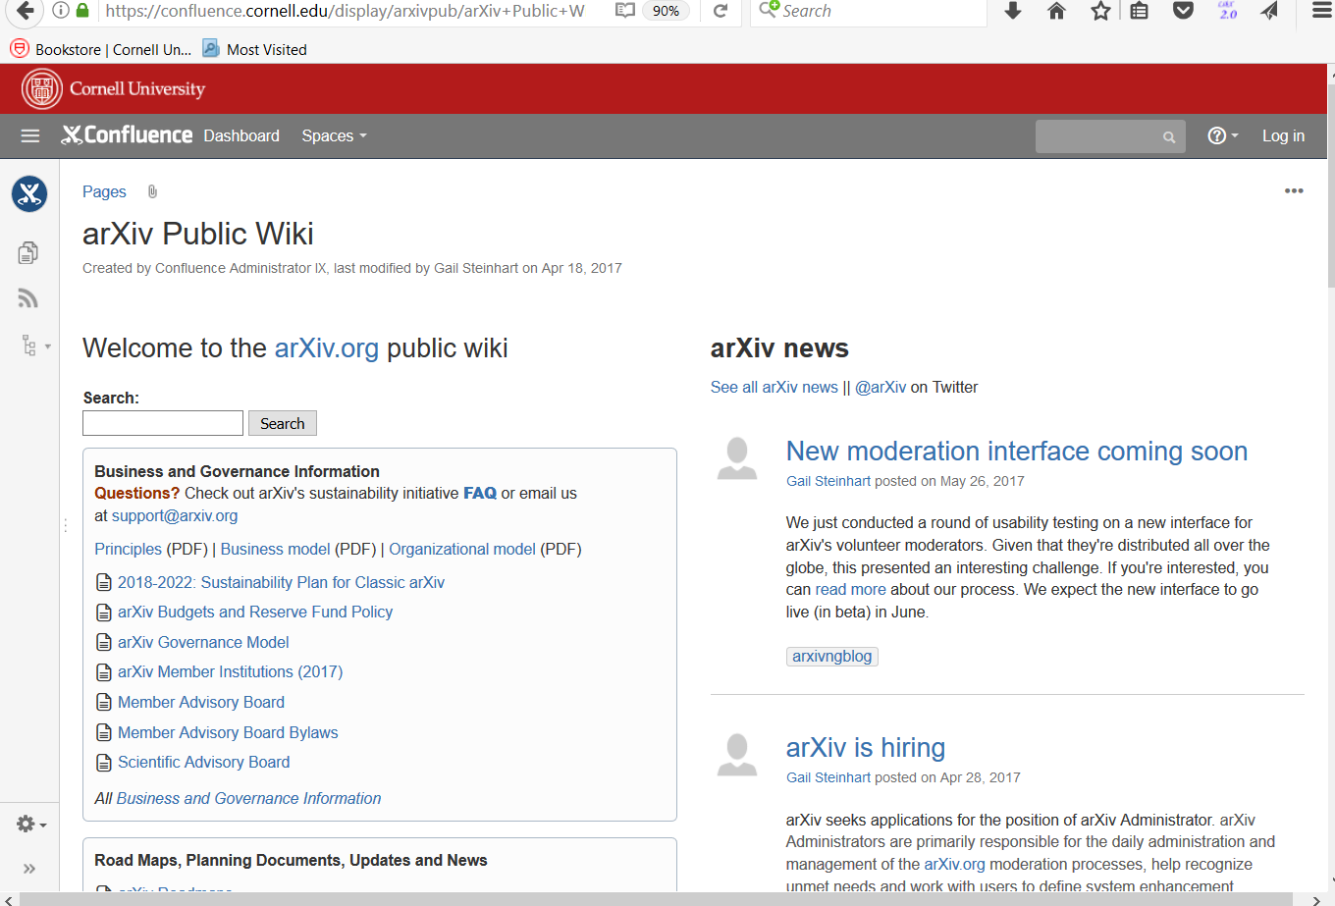
https://confluence.cornell.edu/display/arxivpub/arXiv+Public+Wiki

