Slide 1
Next Generation Preprint Service
Philip E. Bourne PhD, FACMI

Slide 2
Next Generation Preprint Service & Beyond
Philip E. Bourne PhD, FACMI

Slide 3
Who am I representing and what is my bias?
I am representing myself NOT NIH, but, after May 1, possibly the University of Virginia
Keen supporter of preprints and ASAPbio
Former President International Society for Computational Biology
Total data parasite
Unnatural interest in scholarly communication
Co-founded and founding EIC PLOS Computational Biology – OA advocate
Prior co-Director Protein Data Bank
Became an active researcher in scholarly communication

Slide 4
Scholarly Communication - Current Landscape
Largely a for-profit business with limited input into that business from the producers of scholarship
Open access (OA) constrains costs but also shifts the cost from consumer to producer
Full accessibility for non-OA is constrained/controlled
Funders able to influence the landscape eg PubMed Central
Sustainable!
An analog system functioning in a digital world – aka not born digital

Slide 5
If you were inventing scholarly communication today it would look completely different than what it is ….
Preprints are a step in the evolution of scholarship
Preprints offer scholarly communication a fresh start for they are born digital

Slide 6
I just told you the why, now consider the what and the how?
But wait… what is the end game ... Where do we want to be in 10 years?

Slide 7
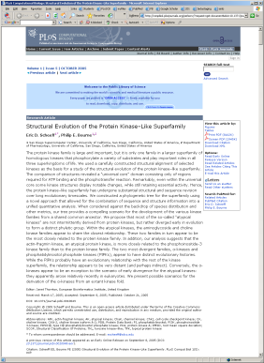
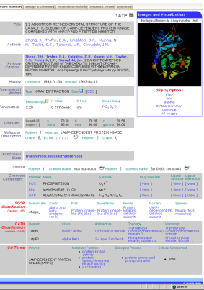
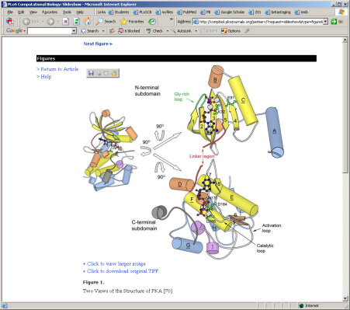
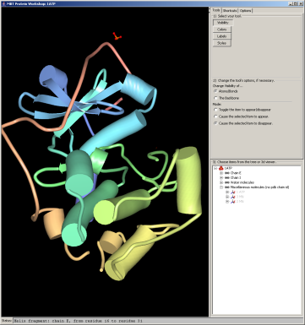
One Hypothetical End Point
0. Full text of paper stored
in a database – one view
4. The composite view has
links to pertinent blocks
of literature text and back to the PDB
Paper is one attributable view of the knowledge
User clicks on a static image
Metadata and data provide direct further analysis - an executable paper
Private and public annotations revealed
Selecting a feature forms a query for yet further knowledge
That knowledge rendered as a knowledge graph rather than a paper
4.
1.
1. A link brings up figures
from the paper
3. A composite view of
journal and database
content results
3.
2.
2. Clicking the paper figure retrieves
data from the PDB which is
analyzed
PLoS Comp. Biol. 2005 1(3) e34
Notes:
7

Slide 8
Why a preprint service is an important step
Preprints have many advantages you have heard about already today - there are incentives
If publishers were going to do it – they would have done it already
Provides unfettered content (in principle)
That content is owned and governed by the community
Provides a playground from which the unimaginable can happen

Slide 9
So what do we need to consider to get there?
Appropriate governance
Incentives
Accessibility of content
Legal
Technical
Ease of use
Sustainability
Open and collaborative
This is too much for one group to accomplish – the effort must be open for all to contribute with appropriate moderation – crowd source model

Slide 10
How do we get there?
ASAPbio governance
Incentives:
Funders – better scientific evaluation
Scientists – timely and greater dissemination of their work
Publishers/others – new business models for value added services
All – improved forms of comprehension eg visualization, aggregation, distillation
Accessibility
Licenses that retain copyright ownership but give unfettered access with attribution

Slide 11
How do we get there?
Accessibility
Technical
Appropriately tagged content
Machine readable content
Appropriate APIs to provide full access
Sustainability
Over time a value proposition for funders
Tools that lower costs for publishers – savings passed on
Open and collaborative
Knowledge becomes a community responsibility
Innovation can come from anywhere

Slide 12
The Beyond – one hypothetical scenario – if you liked x you may like y
You having submitted a significant number of preprints to the preprint service, software from a collaborative development effort has analyzed your submissions and built a researcher profile.
That profile is matched against each incoming submission to the preprint service and periodically rank orders and reports those most relevant to you – a knowledge push. PubMed related articles feature on steroids.
Steroids because methods benefit from the work of a large community of developers.

Slide 13
In Summary
An appropriate preprint service is a framework for innovation
When the World Wide Web took hold no one perceived the rise of social networks and their impact. Likewise few saw the implications for fake news when everyone has a voice and an ear
It is the responsibility of the scientific community at large and the societies that represent those communities to make the most responsible use of innovations in scholarly communication, including preprints

