Slide 1

Role of peer review in journal evaluation
Joyce E.B. Backus
Associate Director for Library Operations

Slide 2
National Library of Medicine at NIH
MEDLINE – 26 million records, 5,400 journals
PMC (PubMed Central) – 4.7 M articles
JATS – Journal Article Tag Suite
ClinicalTrials.gov – 265,000 studies
GenBank - 196 M sequences, > 370,000 species
dbGaP - 700 Clinical studies involving over 1.2 M people
PubChem – 90 M unique chemical structures
And more

Slide 3
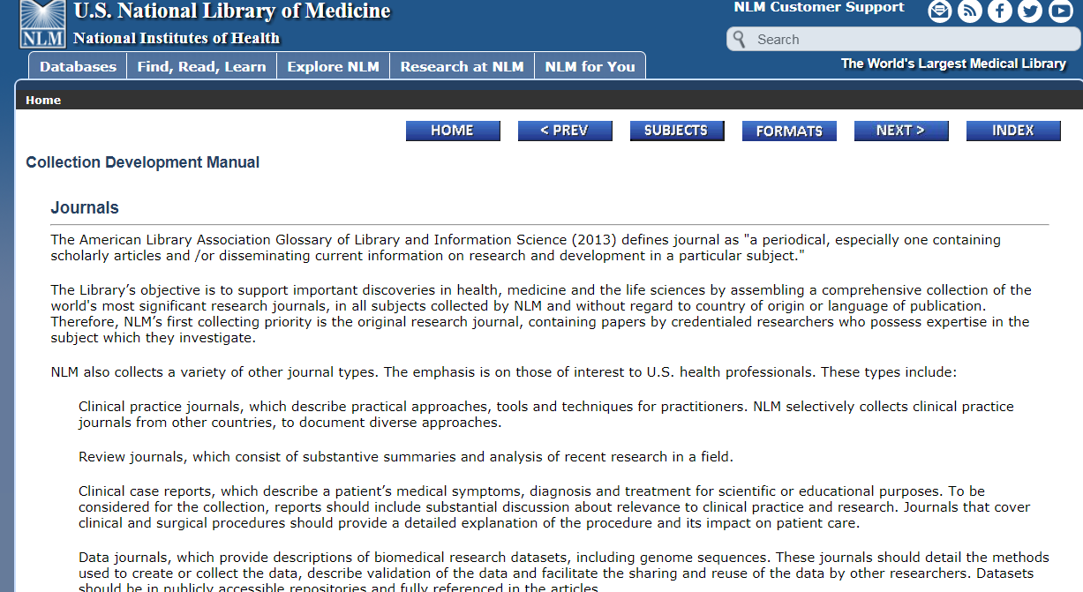
NLM Journal Selection Policy
Generally, NLM looks for
Editorial Quality
Objectivity
Credibility
Scientific Quality
Specific elements include
Article selection methods
Peer review process
Adherence to ethical guidelines
Disclosure of conflicts of interest
https://www.nlm.nih.gov/tsd/acquisitions/cdm/formats29.html

Slide 4
Peer review
The journal should demonstrate features that contribute to the objectivity, credibility, and quality of its contents. These features may include information about the methods of selecting articles, especially on the explicit process of external peer review
Fact Sheet: MEDLINE® Journal Selection https://www.nlm.nih.gov/pubs/factsheets/jsel.html

Slide 5

PMC and MEDLINE
PMC - PubMed Central
Archive of full text – 2000
Supports government public access policies
Expert consultants
Scientific editorial quality
Technical quality (xml, image quality, supplementary data)
MEDLINE
Journal citations – online since 1971
Federal Advisory Committee (modeled on NIH grant review process)
Quality of content
Quality of editorial work

Slide 6
Peer Review
Transparency – publicly stated process and evidence it’s followed
Possible evidence for lack of peer review
The methods descriptions are minimal and/or lack key experimental details
Limitations of the study aren’t addressed
Flawed interpretation of results
Errors of fact
Figures and tables improperly or not labeled
Missing relevant ethics statements

Slide 7
Submitted papers are sent for double-blind peer review evaluation to decide whether they should be published or not, suggesting improvements, asking the authors for clarification and making recommendations to the Editor-in Chief.
All contributions that are considered by the editors to be within the aim and scope of the journal are subjected to peer review by at least two reviewers. Decision of publication is made by the editorial board as per the direction of the reviewers and the responses to the queries of reviewers from the author(s).”

Slide 8
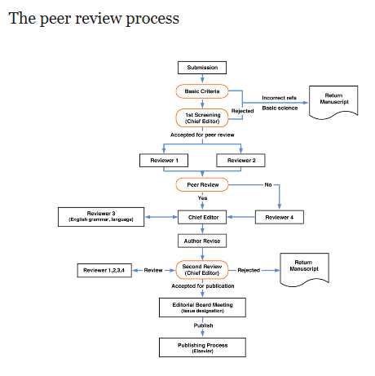
Biochemistry and Biophysics Reports
This journal operates a single blind review process. All contributions will be initially assessed by the editor for suitability for the journal. Papers deemed suitable are then typically sent to a minimum of two independent expert reviewers to assess the scientific quality of the paper. The Editor is responsible for the final decision regarding acceptance or rejection of articles. The Editor's decision is final.
https://www.elsevier.com/journals/biochemistry-and-biophysics-reports/2405-5808/guide-for-authors
Bioengineering
http://www.mdpi.com/journal/bioengineering/instructions
Initial Checks
All submitted manuscripts received by the Editorial Office will be checked by a professional in-house Managing Editor to determine whether it is properly prepared and whether the manuscript follows the ethical policies of the journal, including those for human and animal experimentation. Manuscripts that do not fit the journals ethical policy will be rejected before peer-review. Manuscripts that are not properly prepared will be returned to the authors for revision and resubmission. After these checks, the Managing Editor will consult the journals’ Editor-in-Chief or the Guest Editor (or an Editorial Board member in case of a conflict of interest) to determine whether the manuscript fits the scope of the journal and whether it is scientifically sound. No judgment on the significance or potential impact of the work will be made at this stage. Reject decisions at this stage will be verified by the Editor-in-Chief.
Peer-Review
Once a manuscript passes the initial checks, it will be assigned to at least two independent experts for peer-review. A single-blind review is applied, where authors' identities are known to reviewers. Peer review comments are confidential and will only be disclosed with the express agreement of the reviewer.
In the case of regular submissions, in-house assistant editors will invite experts, including recommendations by an academic editor. These experts may also include Editorial Board members and Guest Editors of the journal. In the case of a special issue, the Guest Editor will advise on the selection of reviewers.
Potential reviewers suggested by the authors may also be considered. Reviewers should not have published with any of the co-authors during the past five years and should not currently work or collaborate with one of the institutes of the co-authors of the submitted manuscript.
Editorial Decision and Revision
All the articles, reviews and communications published in MDPI journals go through the peer-review process and receive at least two reviews. The in-house editor will communicate the decision of the academic editor, which will be one of the following:
Accept after Minor Revisions:
The paper is in principle accepted after revision based on the reviewer’s comments. Authors are given five days for minor revisions.
Reconsider after Major Revisions:
The acceptance of the manuscript would depend on the revisions. The author needs to provide a point by point response or provide a rebuttal if some of the reviewer’s comments cannot be revised. Usually, only one round of major revisions is allowed. Authors will be asked to resubmit the revised paper within ten days and the revised version will be returned to the reviewer for further comments.
Reject and Encourage Resubmission:
An article where additional experiments are needed to support the conclusions will be rejected and the authors will be encouraged to re-submit the paper once further experiments have been conducted.
Reject:
The article has serious flaws, makes no original contribution, and the paper is rejected with no offer of resubmission to the journal.
All reviewer comments should be responded to in a point-by-point fashion. Where the authors disagree with a reviewer, they must provide a clear response.

Slide 9

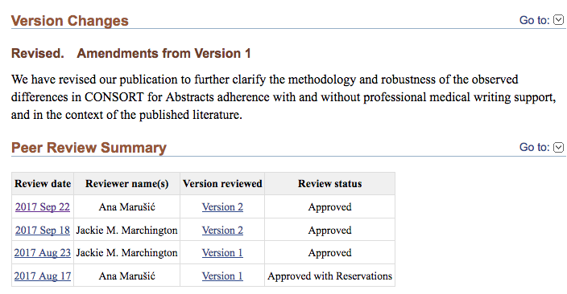
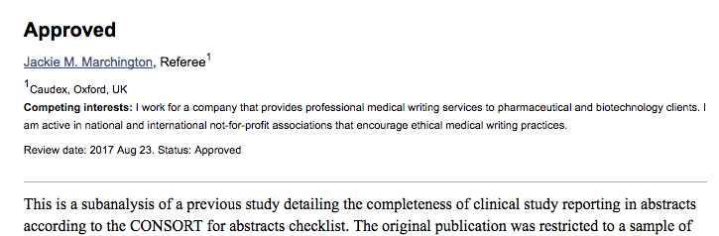
Open peer review in PMC – sample implementations
Open Post-Publication Peer Review
Model used by F1000Research and Wellcome Open Research
Includes summary of version changes (when applicable) and peer reviews
PMC builds Peer Review Summary table for increased transparency
Each peer review is
captured as <sub-article> with a @sub-article-type=“peer review”
assigned a DOI

Slide 10
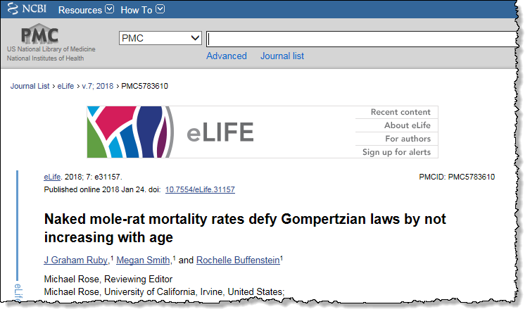
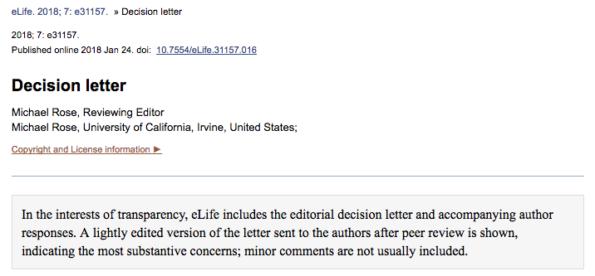
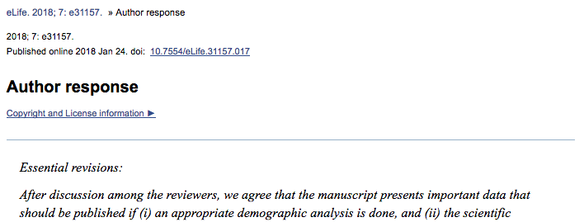
Open peer review in PMC – sample implementations
Open Peer Review Reports and Author Response
Model used by eLife. Other journals may provide this content as supplementary material.
Includes editorial decision, reviewer comments, and author response.
The Decision Letter is
captured as <sub-article> with a @sub-article-type=“commentary”
assigned a DOI
The Author Response is
captured <sub-article> with a @sub-article-type=“reply”
assigned a DOI

