Slide 1
Perspectives on Peer Review and Enhancing Rigor and Transparency of Scientific Research
Michael S Lauer, MD
Deputy Director for Extramural Research, National Institutes of Health
ASAPBio, Wellcome Trust, and HHMI Meeting on Transparency, Recognition, and Innovation in Peer Review in the Life Sciences
February 7, 2018
HHMI Auditorium, 4000 Jones Bridge Road, Chevy Chase, MD
Conflicts: None

Slide 2
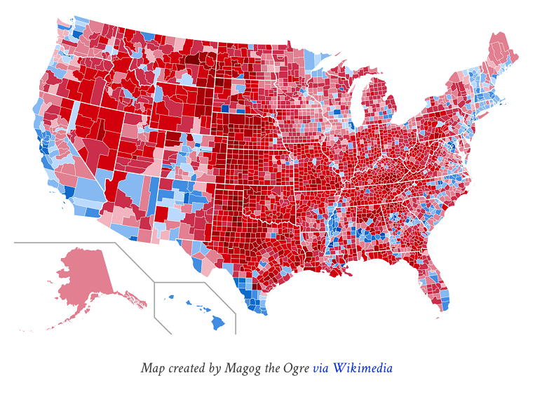
What Do You Think About This?
“A study of the incidence of kidney cancer in the 3,141 counties of the US reveals a remarkable pattern. The counties in which the incidence of kidney cancer is lowest are mostly rural, sparsely populated, and located in traditionally [Red] states. What do you make of this?”
http://brilliantmaps.com/2016-county-election-map/
Kahneman D. Thinking Fast and Slow. FSG, 2011. Page 109

Slide 3
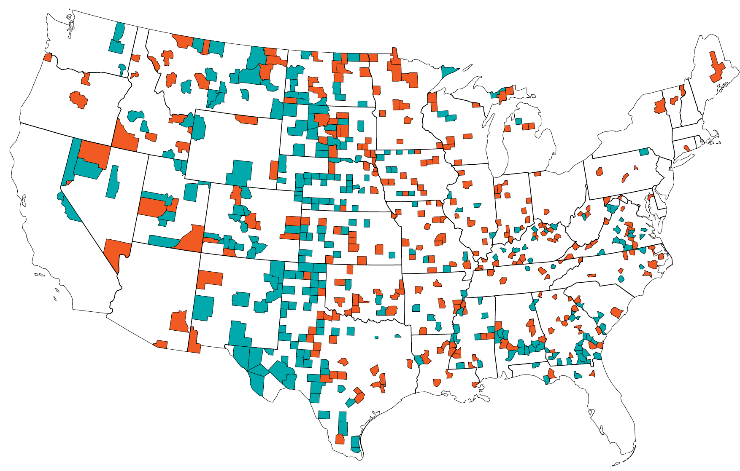
Another Look
Wainer H. Am Scientist 2009;95:249-56

Slide 4
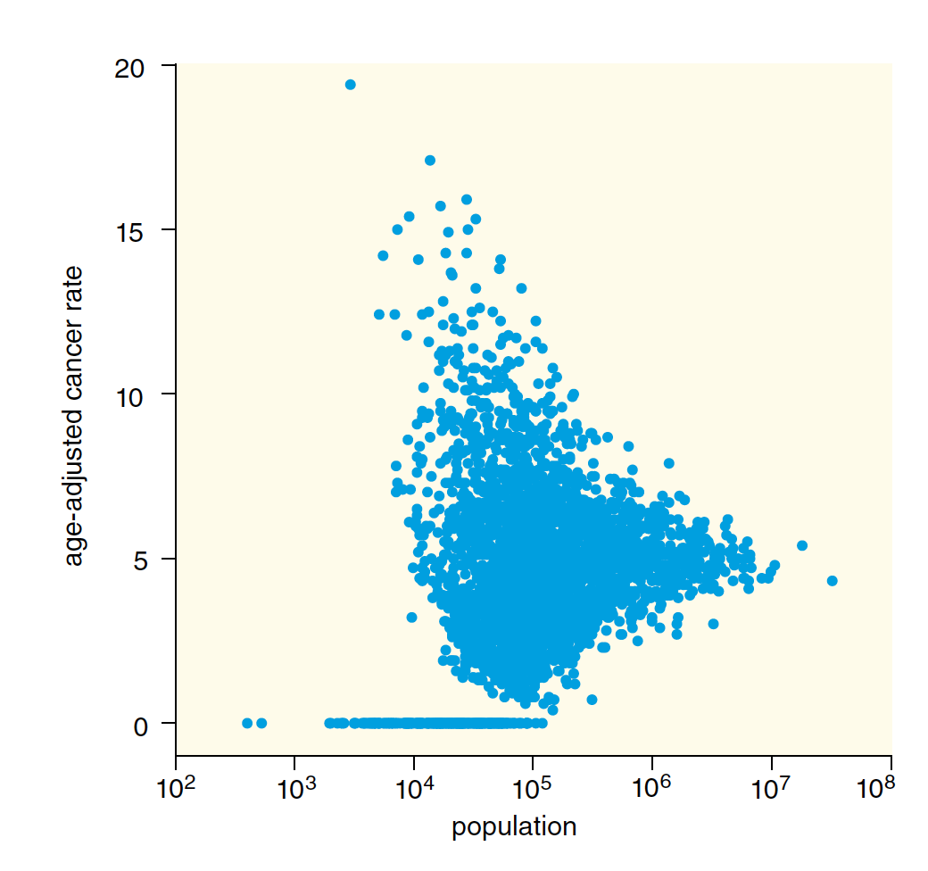
Yet Another Look…
Wainer H. Am Scientist 2009;95:249-56

Slide 5

It’s Fundamental: “Law of Small Numbers” …
“Large samples are more precise than small samples. [This means that] small samples yield extreme results more often than large samples. The exaggerated faith in small samples is only one example of a more general illusion: a view of the world that is simpler than the data justify.”
Daniel Kahneman
Kahneman D. Farrar, Straus, and Giroux. 2011

Slide 6
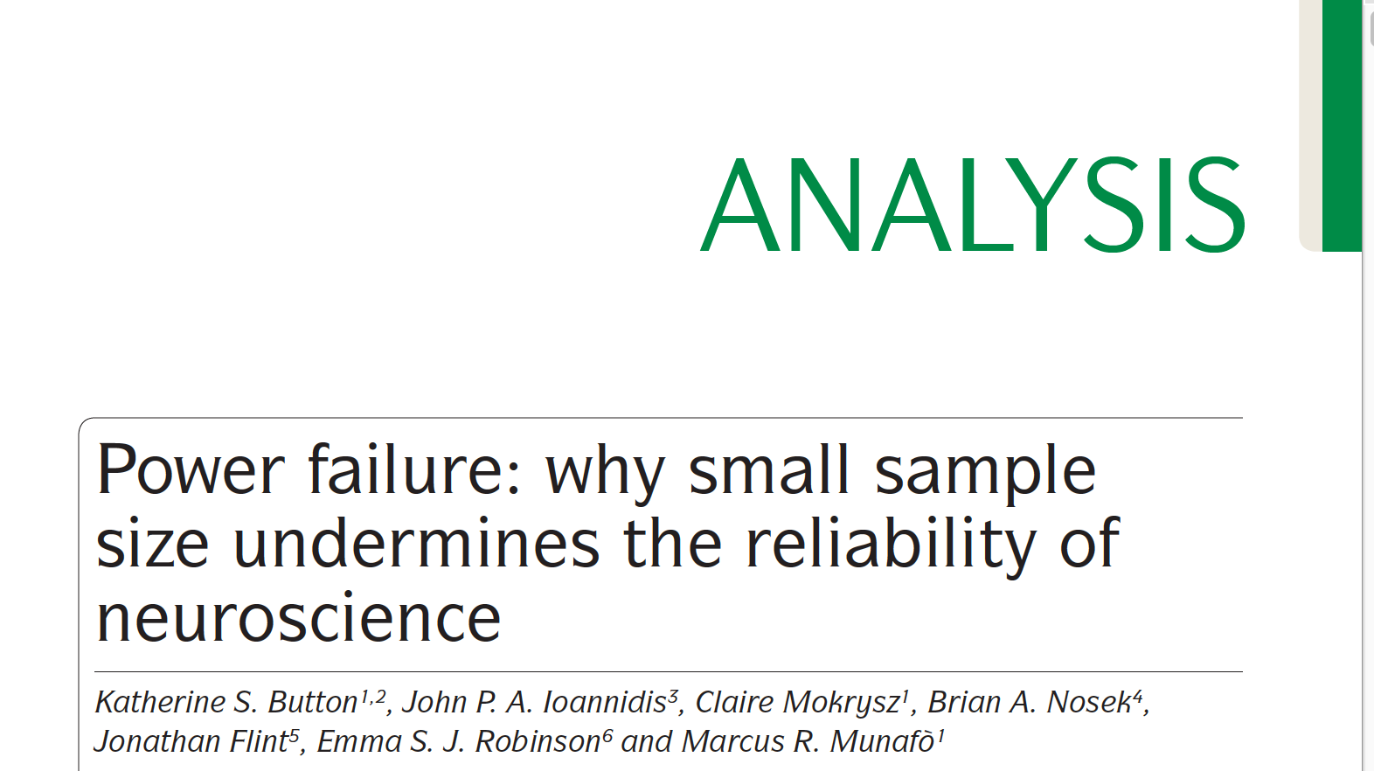
And It’s Endemic …
“A study with low statistical power has a reduced chance of detecting a true effect, but it is less well appreciated that low power also reduces the likelihood that a statistically significant result reflects a true effect. The average statistical power of studies in the neurosciences is very low. The consequences of this include overestimates of effect size and low reproducibility of results.”
Button KS et al. Nature Reviews Neuroscience. 2013;14:365-76

Slide 7
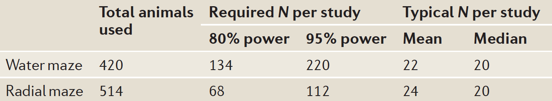
“Power Failure”
“What is particularly striking is the inefficiency of a continued reliance on small sample sizes. … Low power has an ethical dimension – unreliable research is inefficient and wasteful. This applies to both human and animal research."
Button KS et al. Nature Reviews Neuroscience. 2013;14:365-76

Slide 8
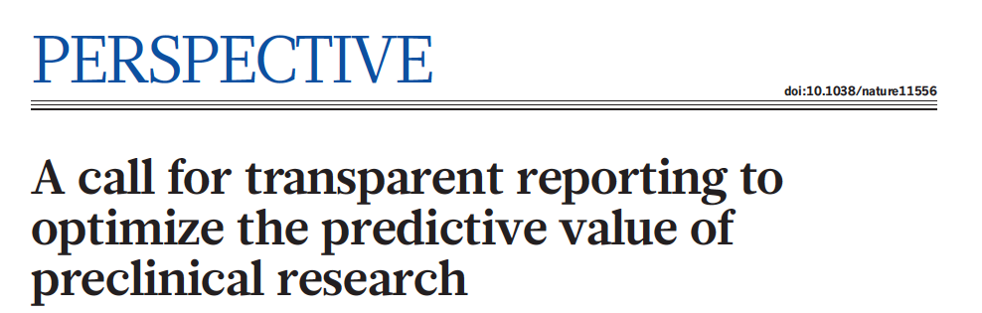
NIH Worries
“… At a mininum studies should report on sample-size estimation, whether and how animals were randomized, whether investigators were blind to the treatment, and the handling of data.”
Landis SC, Silberberg S et al. Nature 2012;490:187-191

Slide 9
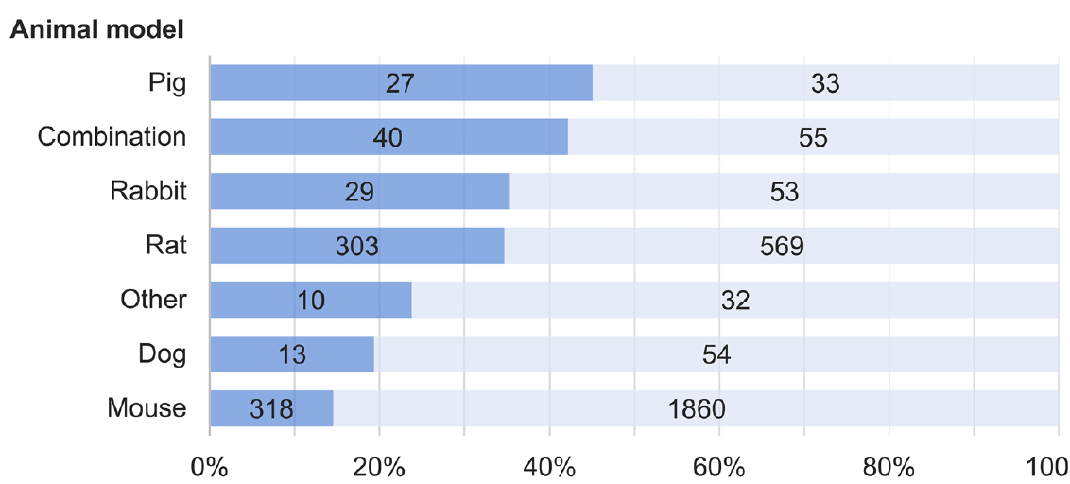
How Well Are We Doing? Randomization…
Ramirez FD, et al. Circulation Research. 2017;120:1916-26

Slide 10
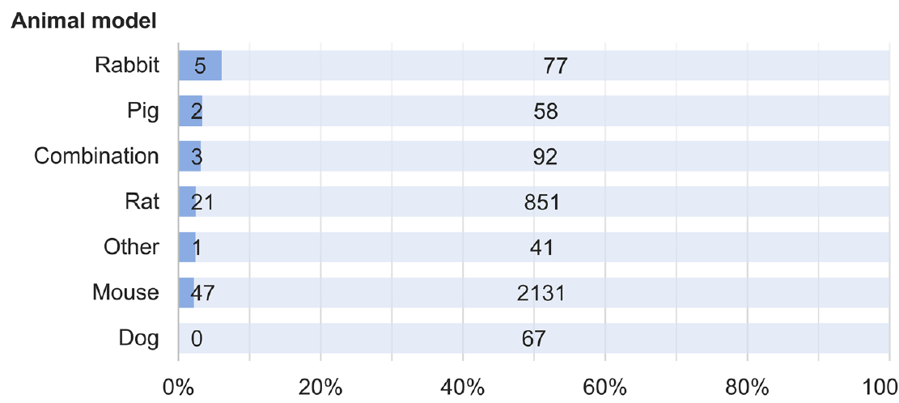
Sample Size Calculation …
Ramirez FD, et al. Circulation Research. 2017;120:1916-26

Slide 11

Is Peer Review (as Currently Practiced) the Answer?
Cressey D. Nature 2015;520:271-2

Slide 12
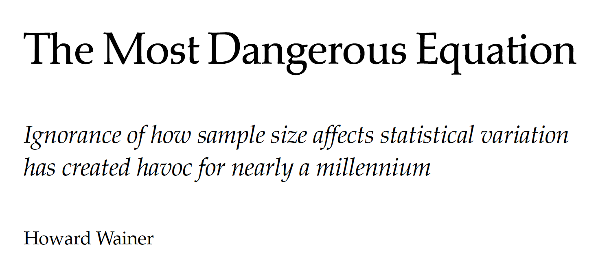
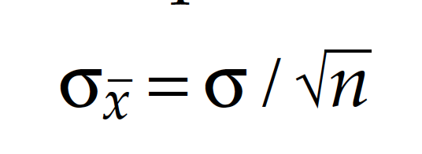
What’s The Problem?
“Ignorance of de Moivre’s equation has led to billions of dollars of loss over centuries yielding untold hardship. … It is no revelation that humans don’t fully comprehend the effect that variation … has …”
So: Who’s in charge? Scientists? Editors? Reviewers? Statisticians?
Wainer H. Am Scientist 2009;95:249-56

Slide 13
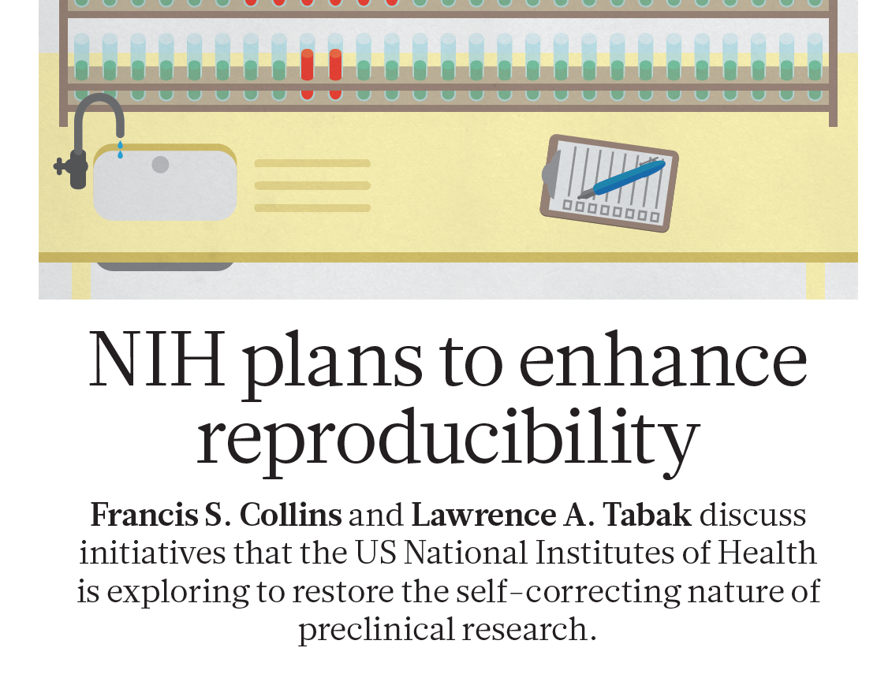
NIH Steps
Nature. 2014;505:612-13

Slide 14
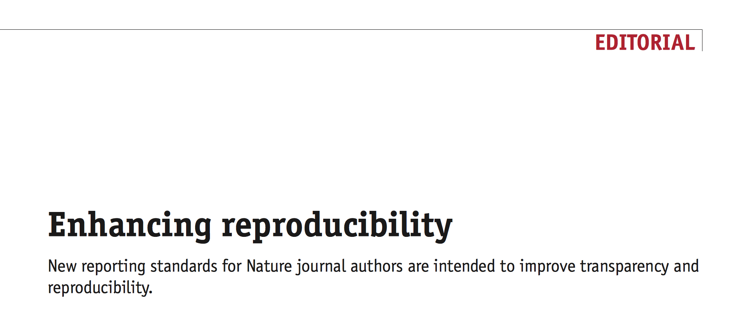
Journals Taking Specific Steps …
Nature Methods. 2013;10:367

Slide 15

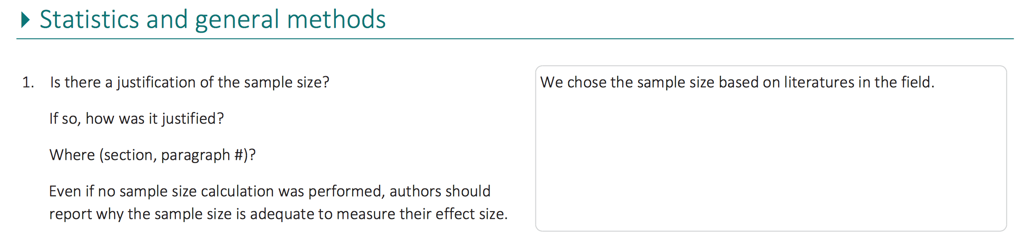
Was There a Statistical Review?
Is there a justification of the sample size?
We chose the sample size based on literatures in the field.
Even if no sample size calculation was performed…
https://authors.library.caltech.edu/47880/13/nn.3767-S2.pdf
Linked to: https://www.nature.com/articles/nn.3767

Slide 16
Closing Thoughts
Who’s in charge? How will we end the endemic?
Can we publish without rigorous statistical review?
Will “transparent” peer review clarify statistical quality?
What about post-publication statistical review?

