Slide 1
F1000: OUR EXPERIENCES WITH PREPRINTS WITH FORMAL POST-PUBLICATION PEER REVIEW
Rebecca Lawrence
Managing Director, F1000
8 February 2018
HHMI Headquarters
rebecca.lawrence@f1000.com

Slide 2
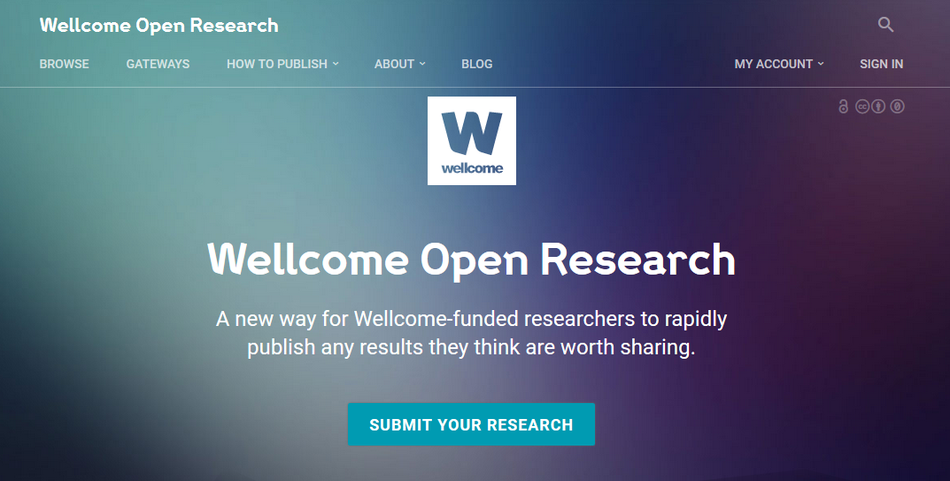

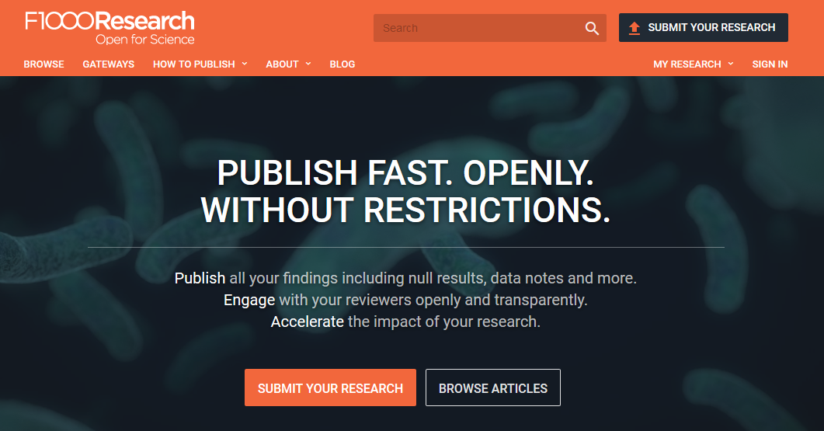

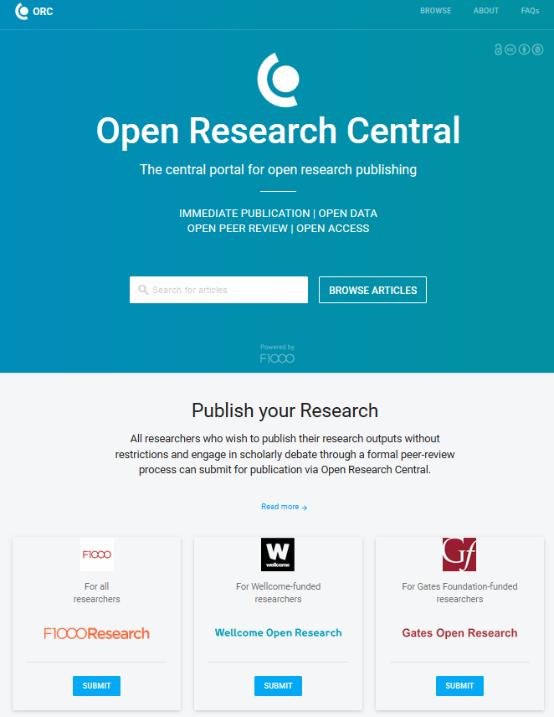



F1000: a service company
@rnl_s | @f1000
Launched 2013
Our own platform to experiment and develop the model

Slide 3
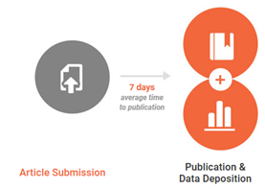
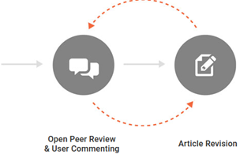
The underlying model
@rnl_s | @f1000
Submission and preprint-like stage
Post-publication peer review and indexing

Slide 4
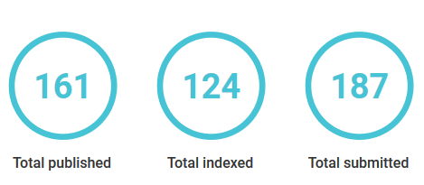
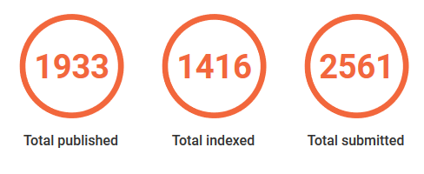
Pre-publication checks
@rnl_s | @f1000
Submission and preprint-like stage
More significant than typical preprint checks:
Scientific work from a scientist, plagiarism check, readable
Meet ethical requirements
Meet community standards
Have source data (required) & FAIR
F1000Research - 75% pass checks
Wellcome Open Research - 86% pass checks

Slide 5
Formal Publication
@rnl_s | @f1000
14-16 working days
2 working days
4-5 working days
Authors dealing with pre-pub queries
Pre-publication checks
Submission
Final submission
Publication
DOI (i.e. citable)
Typeset: NLM-compliant XML + PDF
Metadata: readability, accessibility, text mining
Like preprint except authors commit to formal, invited peer review, post-publication
Authors cannot send this article to a journal

Slide 6
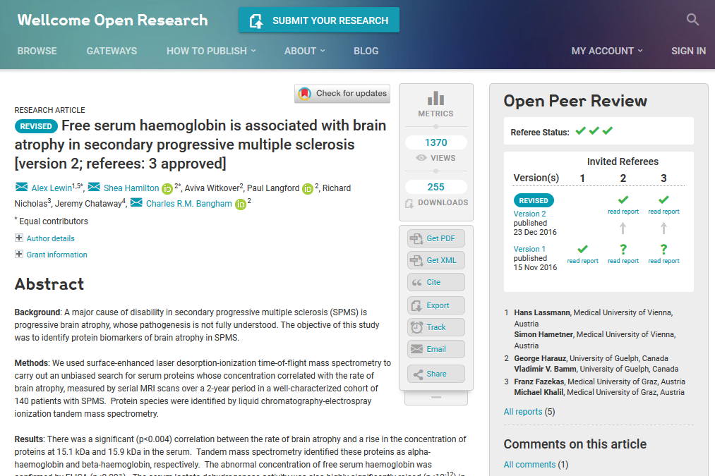





Refereeing and versioning
@rnl_s | @f1000
Authors select referees from a list; checked for experience + conflicts
Referees: + report
Reports published & signed
Authors in charge – no Editors
Authors respond & publish new versions
PubMed: or

Slide 7
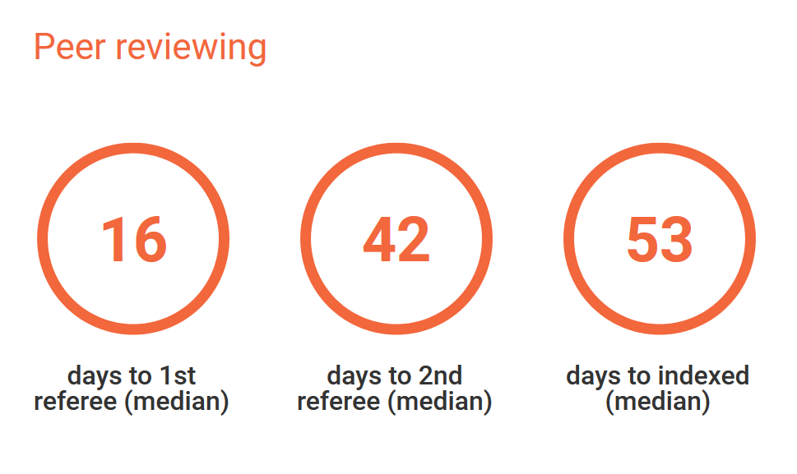
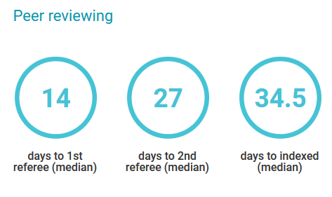
Peer review speed
@rnl_s | @f1000
F1000Research
Hands-on logistical support
Referees get credit
Reports get DOIs (ie citable)
Inclusion in ORCID profiles and Publons
Wellcome Open Research

Slide 8
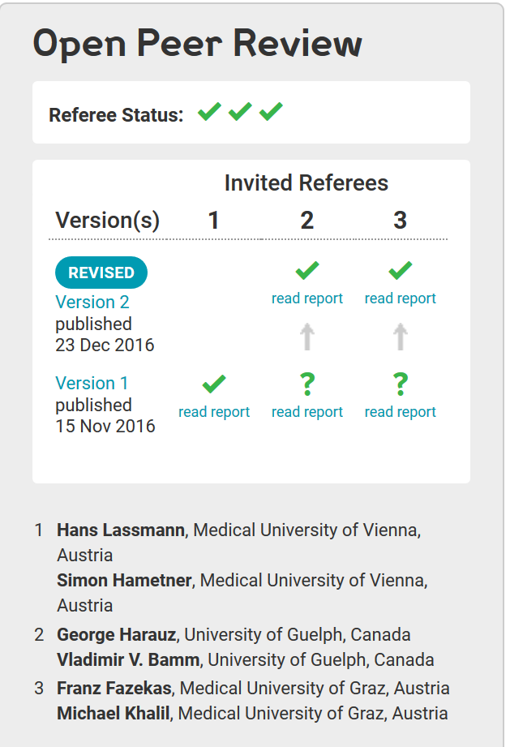
Credit for early career researchers
@rnl_s | @f1000

Slide 9
Technology & infrastructure
@rnl_s | @f1000
Built solid technological infrastructure to handle whole publishing process
Versioning makes significantly more complex
Maximised links with core scholarly infrastructure providers e.g.
major bibliographic indexers
repositories and archives
ORCID
CrossRef
data & software repositories and visualization tools
impact & analysis tools
authoring tools
reference management systems…
Powerful tools to support authors and referees e.g.
referee finders
referee report authoring systems
tools to simplify author-referee discussion and article revision

Slide 10
Learning from our experiences
@rnl_s | @f1000
5+ years – tweaked & adjusted model
Authors in charge & make key decisions: no harder to get reviewers; review process faster; reviews more constructive
Running logistical operation → active participation of referees on each published article
Transparency crucial: authors, referees, readers
We are providers of infrastructure, tools and editorial services to scholarly community to experiment
Keen to collaborate in crucial shift in control from publishers/editors to community

Slide 11

Questions?
rebecca.Lawrence@f1000.com | @rnl_s | @f1000

