Slide 1

OpenReview.net
Five years of open peer review experience
in computer science
Andrew McCallum
Center for Data Science
College of Information and Computer Sciences
University of Massachusetts Amherst
Funding from NSF, IARPA, Google, Amazon, Oracle, CVF, CZI,…

Slide 2
2002-present
Professor, Computer Science
Director, Center for Data Science
UMass Amherst
Machine learning, Natural Language Proc.
h-index 90
Past President International Machine Learning Society
2000-2002
VP R&D, start-up
Info extraction from the web
170 people
1996-2000
Research Scientist, industry research lab
Automated digital library construction

Slide 3
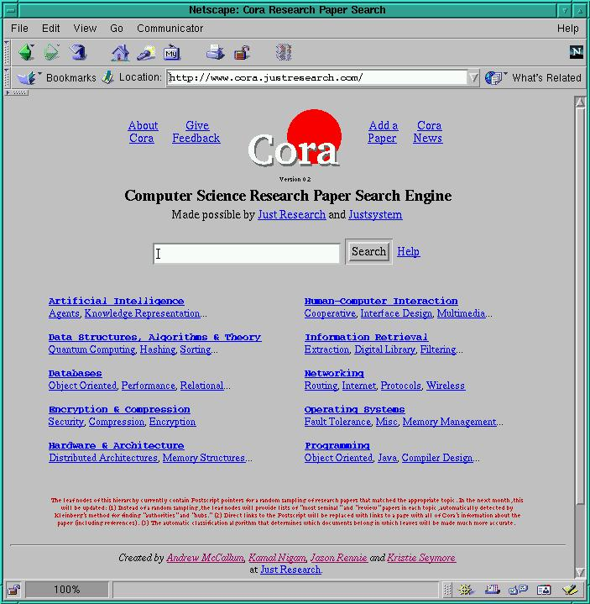
Spider web for PDFs; convert to text
Document classification by topic
Notes:
Live demo at end.
For now, just to give you the idea, show you three screenshots.
Cora front page.
Topic hierarchy, search form

Slide 4
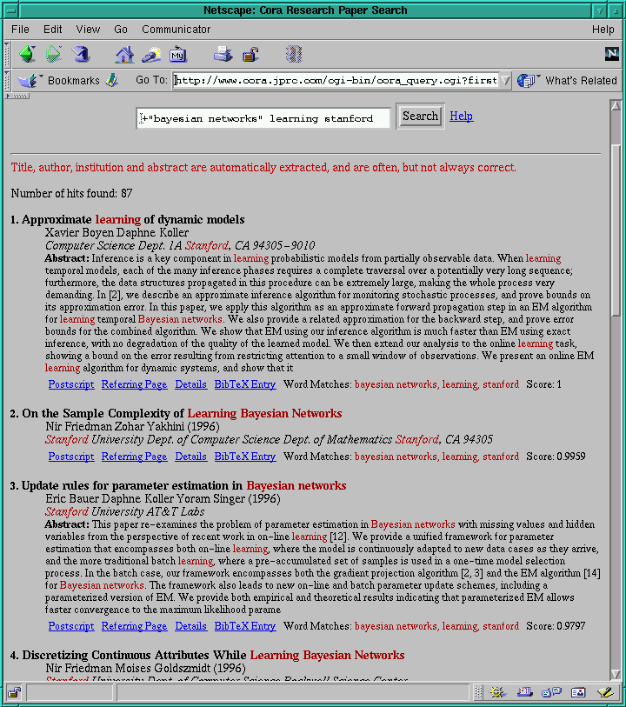
Extraction of metadata

Slide 5
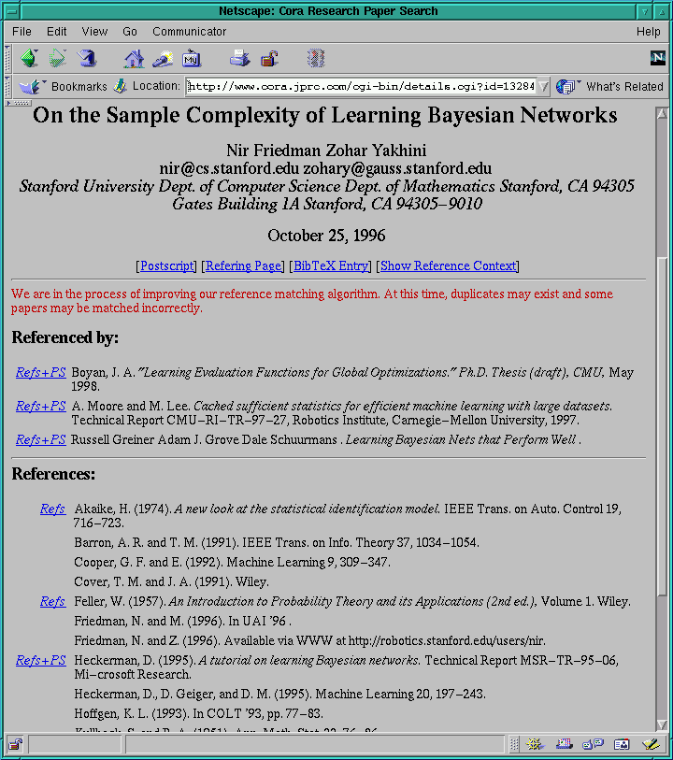
Paper & citation resolution

Slide 6
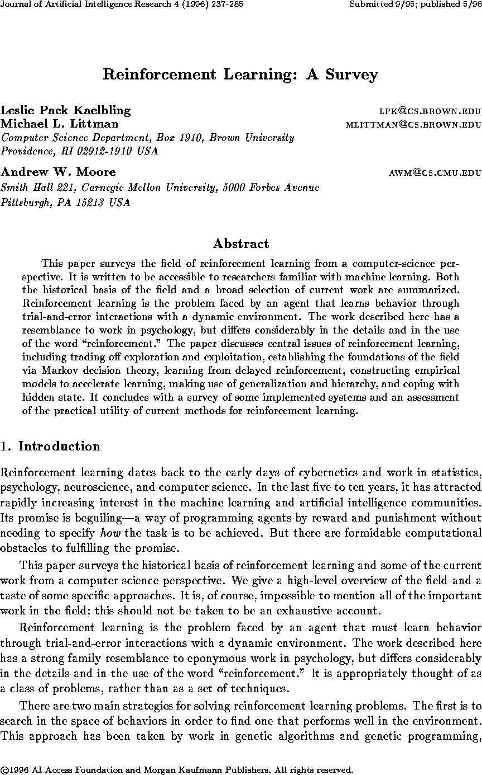
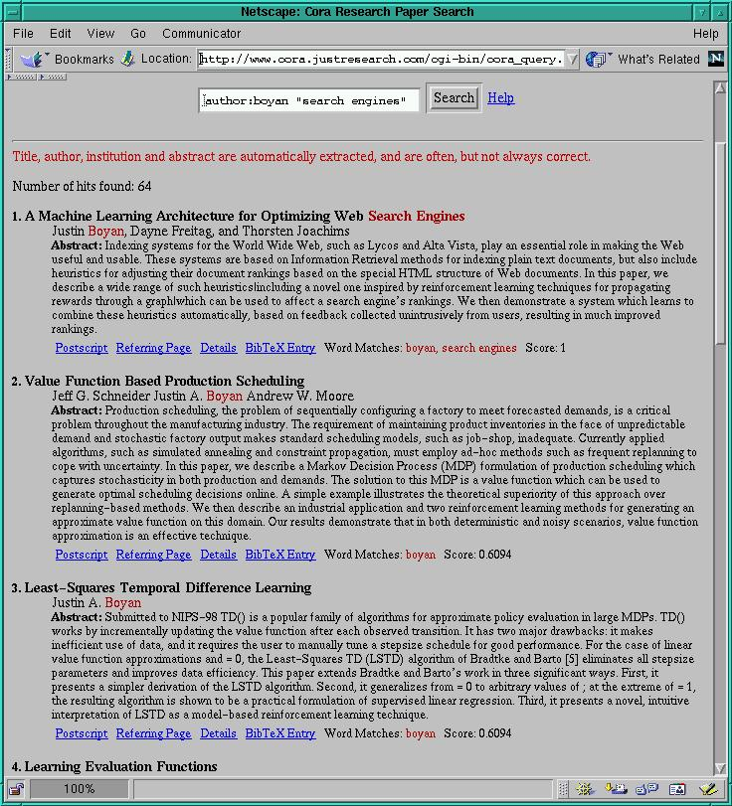
Building a Searchable Library of
Research Papers
[McCallum et al 1996]
Notes:
Some of you might know about Cora, a contemporary of CiteSeer. This is a system created by Kamal Nigam, Kristie Seymore, Jason Rennie and myself that mines the web for Computer Science research papers.
You can view search results in terms of summaries from extracted data. Here you see the automatically extracted titles, authors, institutions and abstracts.

Slide 7
Notes:
Live demo at end.
For now, just to give you the idea, show you three screenshots.
Cora front page.
Topic hierarchy, search form

Slide 10
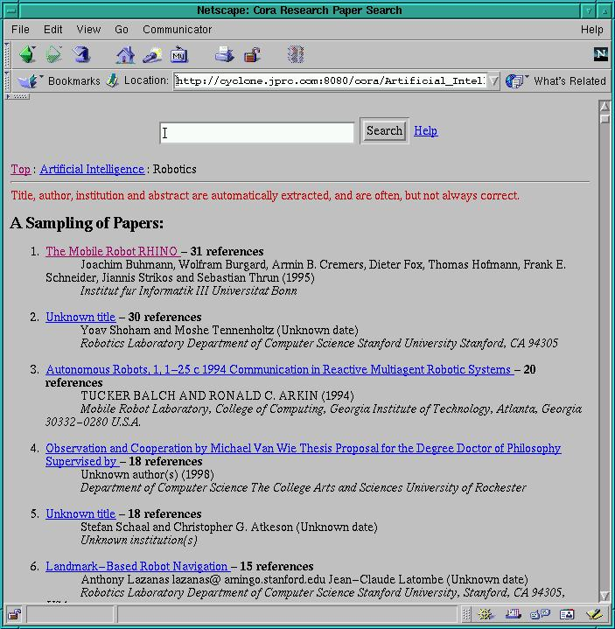
Notes:
You can also browse the hierarchy, and when you get to leaves it shows papers on that topic, ranked by # other papers have cited this paper.
Thrun’s paper at top. But mostly self-refs :-)

Slide 11

Later, at UMass
Notes:
As many of you know

Slide 12
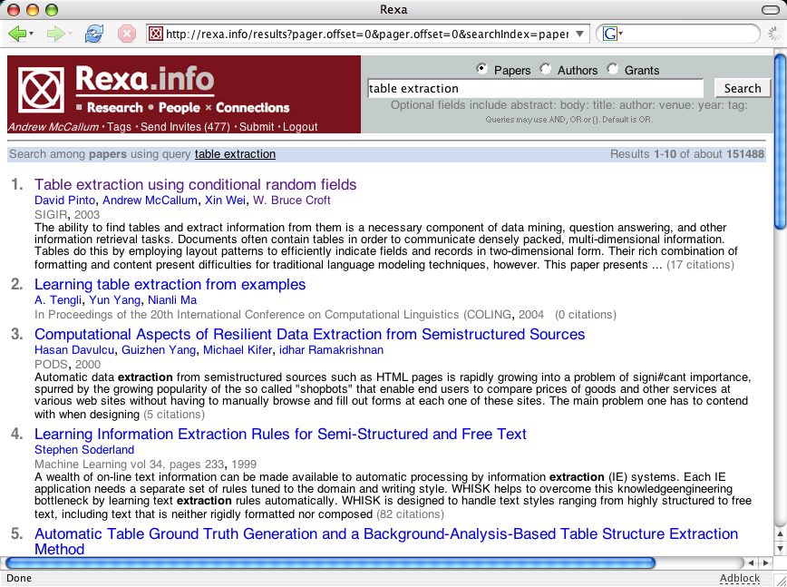

Slide 13
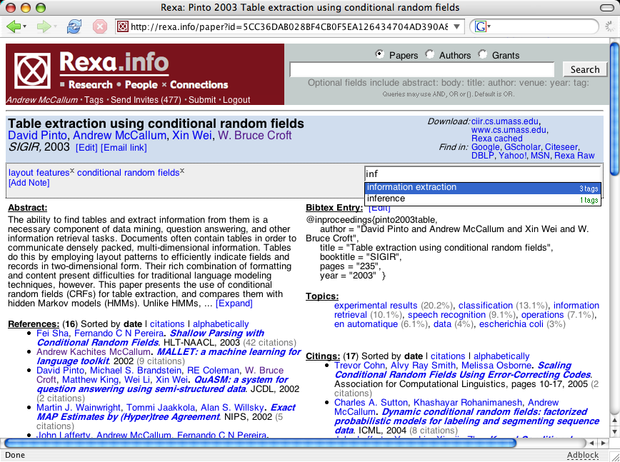

Slide 14
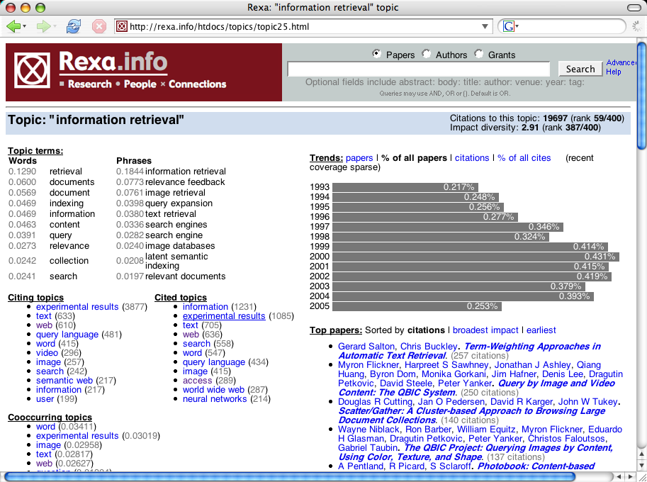

Slide 15
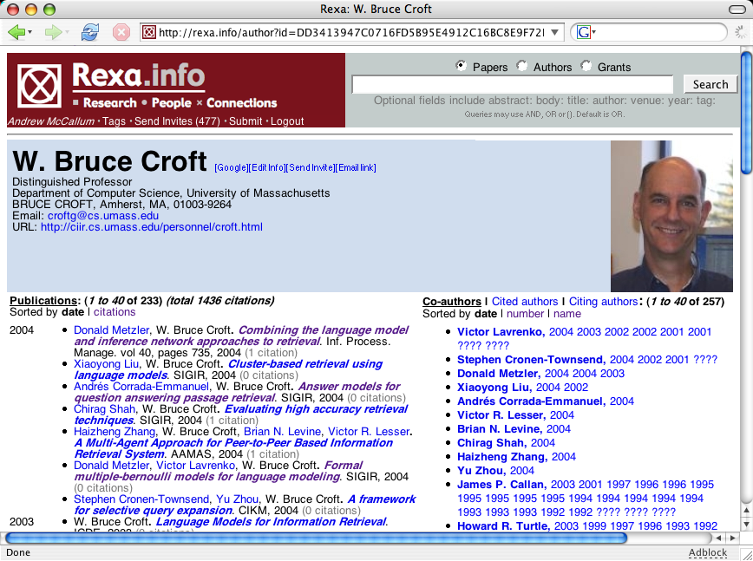
Notes:
institutions, conferences, journals, grants, advisors, ...

Slide 16
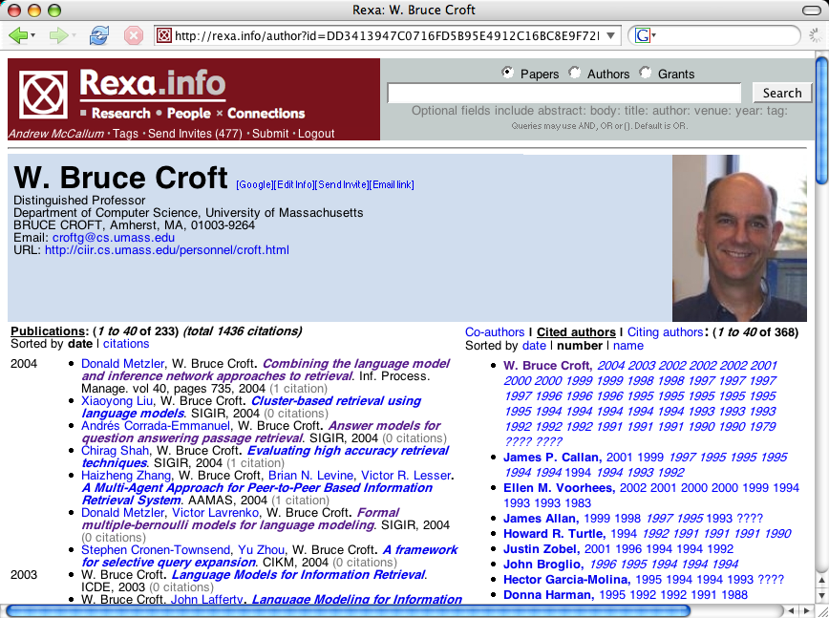

Slide 17
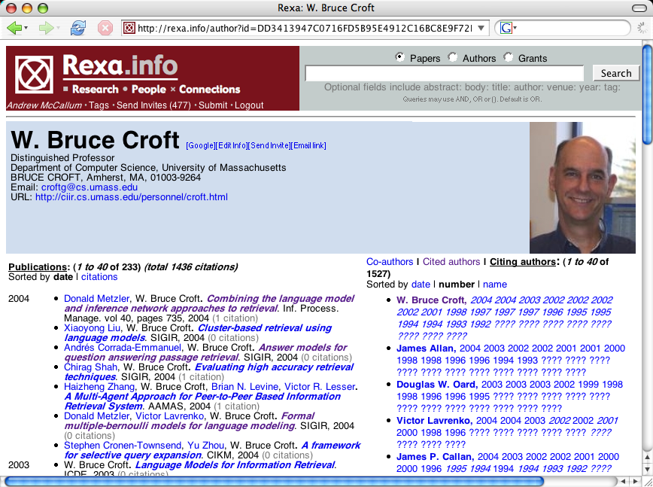
institutions, conferences, journals, grants, advisors,...

Slide 18
Primary Current Projects
A KB of all scientists in the world
from papers, patents, web pages, newswire, press releases, tweets, blogs,...
A KB of scientific entities & relations
materials, equipment, organisms, processes, tasks, methods,...
Better tools → Accelerate progress of science.
Revolutionize peer review
  “open peer review”
  Submission, reviews & comments public.

Slide 19


Comp. Sci. advocates for a
Revolution in Peer Review
Yann LeCun
Director of AI Research at Facebook
Professor of CS, NYU
Problems with traditional peer review
  Paper poorly reviewed, rejected, not disseminated; slows progress.
  Often hidden bias in reviewing.
  Main goal: Maximize “Rate of Progress of Science”
Proposed Publication Model: separate publishing from reviewing
  Put paper on a public archive
  People self-organize into “Reviewing Entities”…
  ...under whose name review appears, and which give stamp of approval
  Reviews are themselves citable documents
  Multiple Reviewing Entities can review the same paper
  Create credit-assignment reputation “karma” system
Concerns?
  Looses blind review, but openness will (hopefully?) prevent blatant bias.

Slide 20
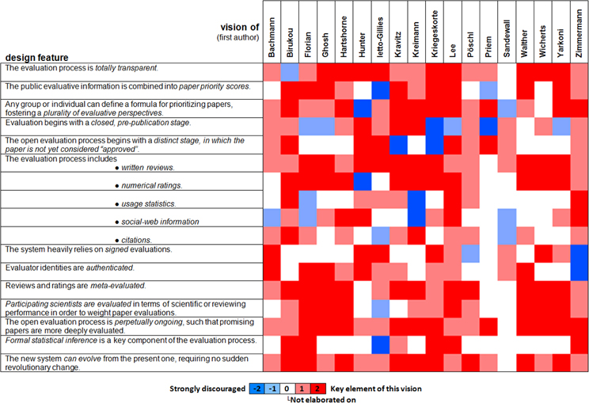
Variations in Proposed Open Peer Review
[Computational Neuroscience, 2012]
Most needed now:
Experimentation and flexibility
on the many dimensions of
open-ness in peer review

Slide 21
Landscape of Open Access & Review
[Soergel, et al]
Open Access:
who has access to what information, when,
and under which conditions
Who
  researchers / authors
  editors
  action editors or "area chairs"
  reviewers
  journal subscribers or conference attendees
  the general public

Slide 22
Landscape of Open Access & Review
[Soergel, et al]
Open Access:
who has access to what information, when,
and under which conditions
What
  submitted manuscripts
  accepted manuscripts
  peer reviews
  comments by volunteers
  author responses
  intra-reviewer discussion
  editors' meta-review
  authors' identities
  editors' identities
  reviewers' identities
  commenters' identities

Slide 23
Landscape of Open Access & Review
[Soergel, et al]
Open Access:
who has access to what information, when,
and under which conditions
When
  During research
  During manuscript writing
  Upon manuscript submission
  During peer review & revision
  Upon decision
  Upon publication
  N months post publication
  Never

Slide 24
Landscape of Open Access & Review
[Soergel, et al]
Open Access:
who has access to what information, when,
and under which conditions
Conditions
  The authors authorize an optional openness feature
  The authors pay a fee to enable an
  optional openness feature
  The reviewers allow their review to be read by
  some selected set of people,
  anonymously or non-anonymously.
  A reader pays a fee to gain access to some information

Slide 25
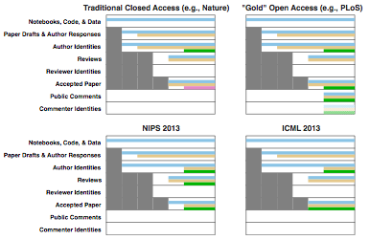
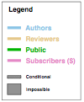

[Soergel, et al]

Slide 26
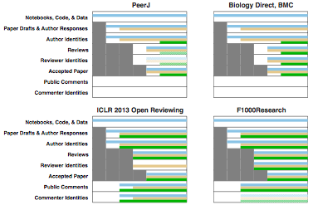
[Soergel, et al]

Slide 28
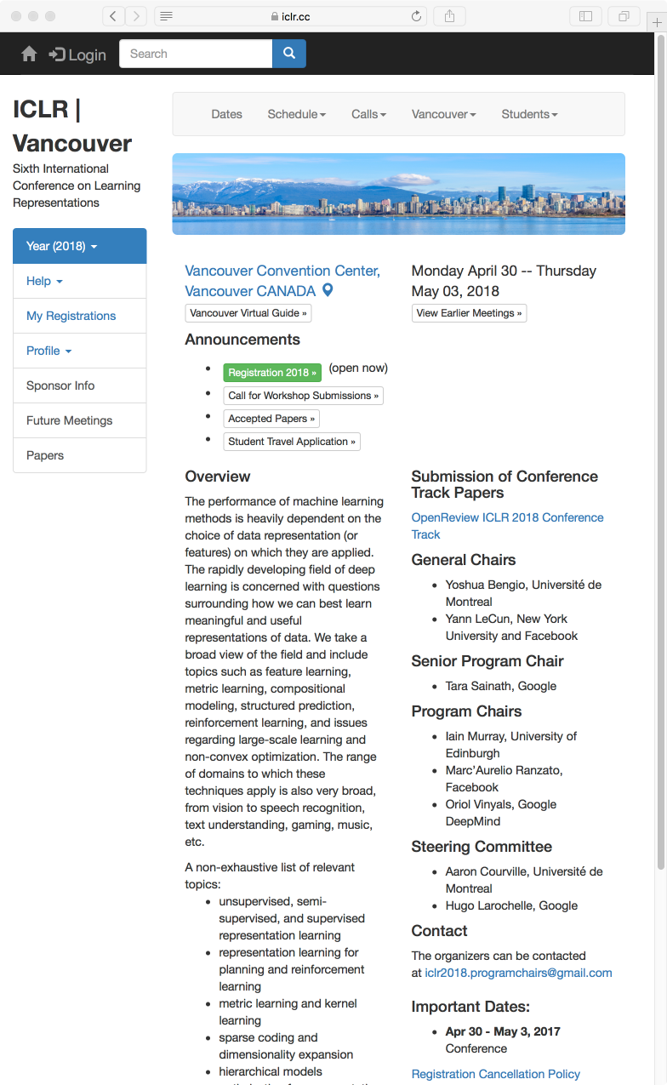

Slide 29
ICLR Reviewing
Submissions posted to ArXiv
Review:
  Eds. assigned 3 reviewers to each paper
  these can review anonymously (or non)
  general public can review non-anonymously
  reviews appear publicly upon entry
  authors, PC, reviewers can msg. pub/privately
Eds. make acceptance decisions
All papers & reviews remain online

Slide 31
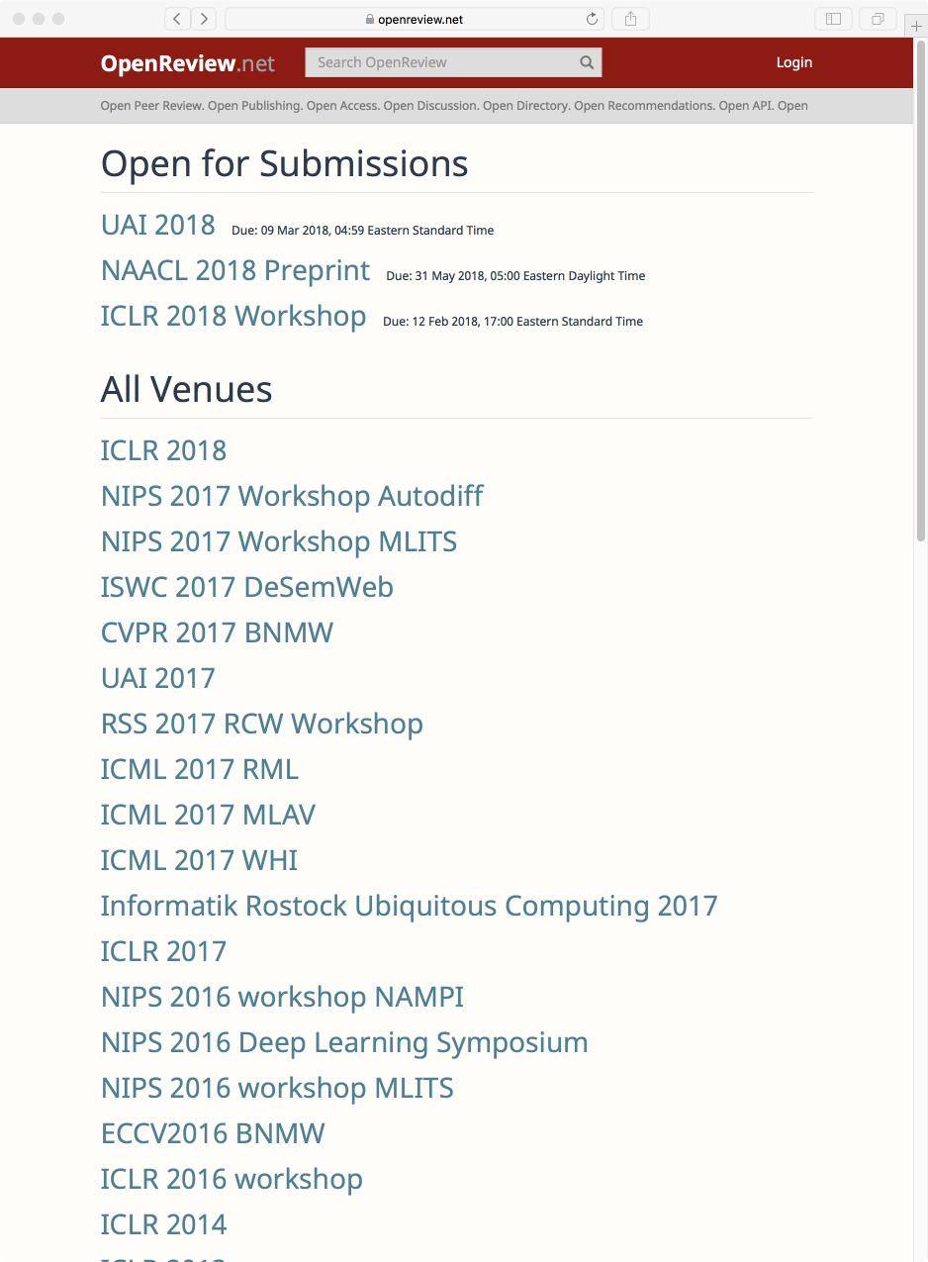
More vigorous reviewing when review process open during review period.
  High-quality dialog between authors, reviewers, commenters in ICLR 2013-2018.
Stogy communities are willing to try small-steps of change.
  UAI allowing all conference reviewers to see all papers and all reviews.
Can have "open review period" with double-blind review!
  ICLR tried for first time in 2018. Submissions are public with no authors listed! All papers (regardless of acceptance) will have authors revealed after 6 week review period.
Anonymous reviews by open public can lead to some "trolling."
  ICLR tried for first time in 2018. Some anonymous volunteer comments seem unscientific. Should insist non-anon.
Growing interest in CS:
CVPR, ECCV, ICML, NIPS...

Slide 32
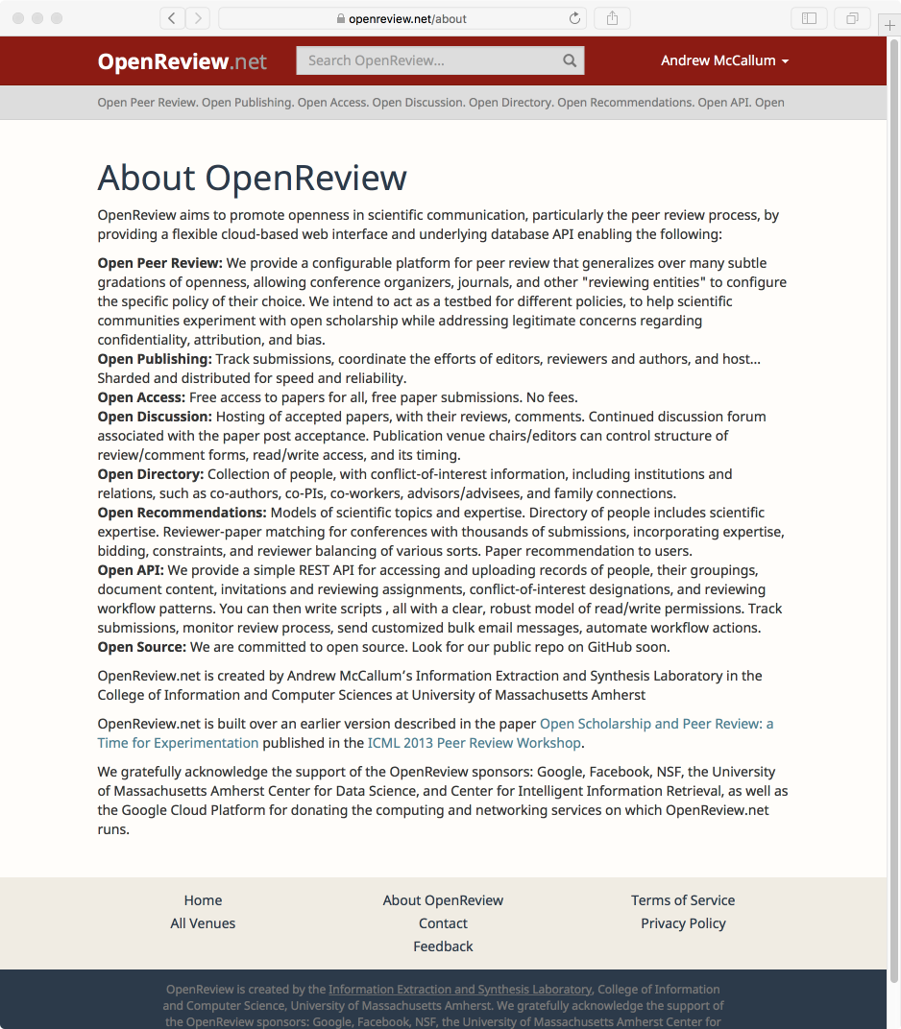

Slide 33
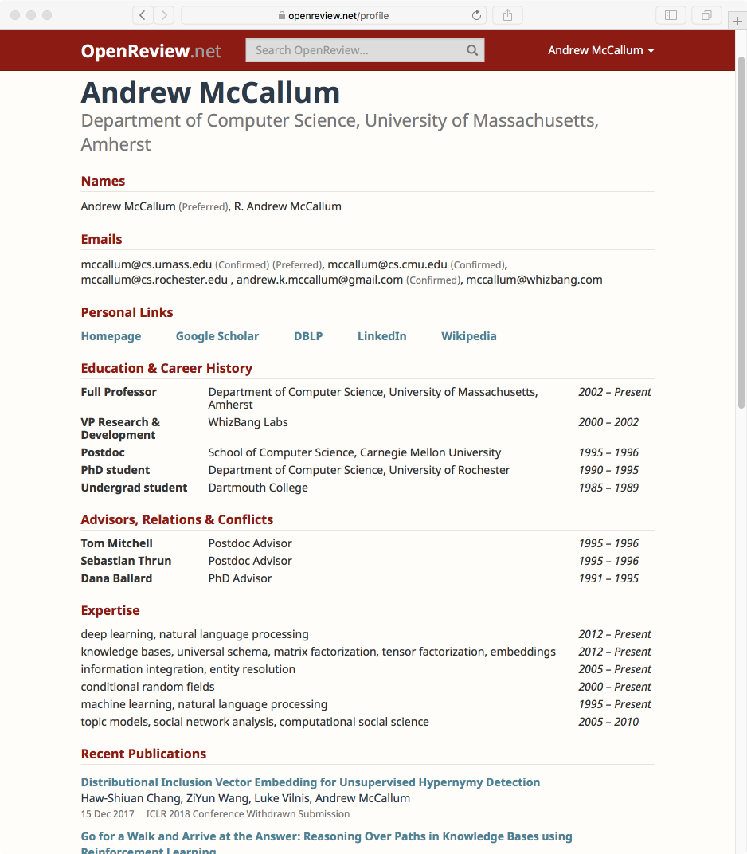

Slide 34
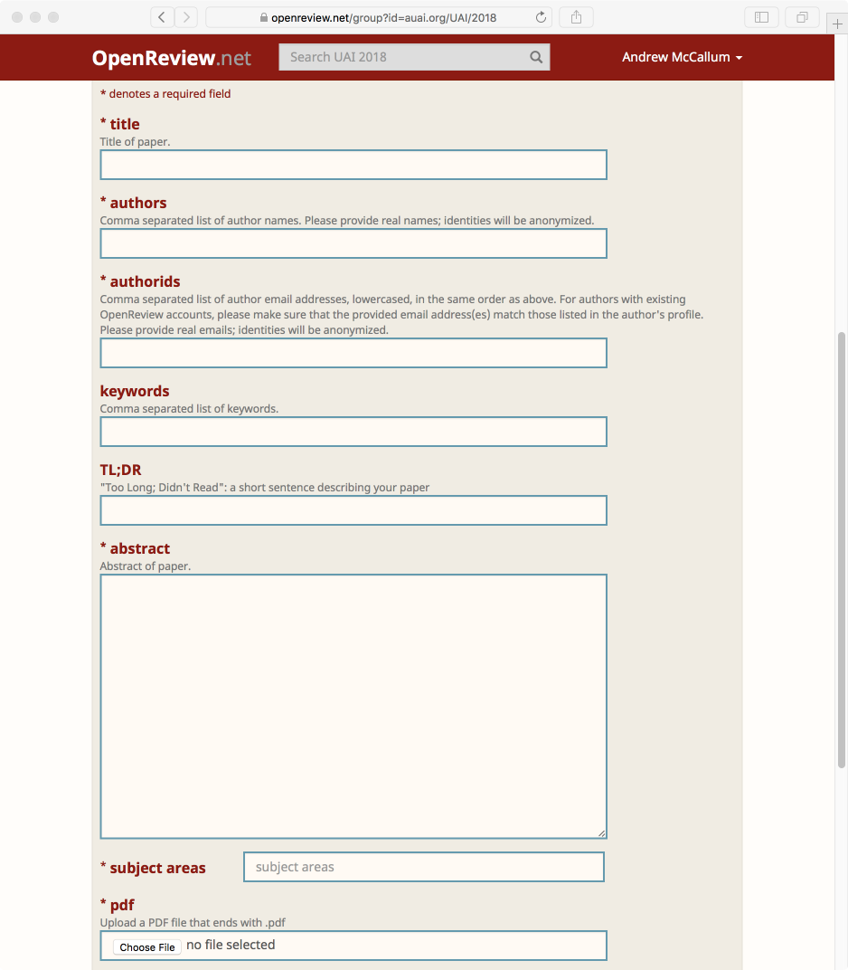

Slide 35
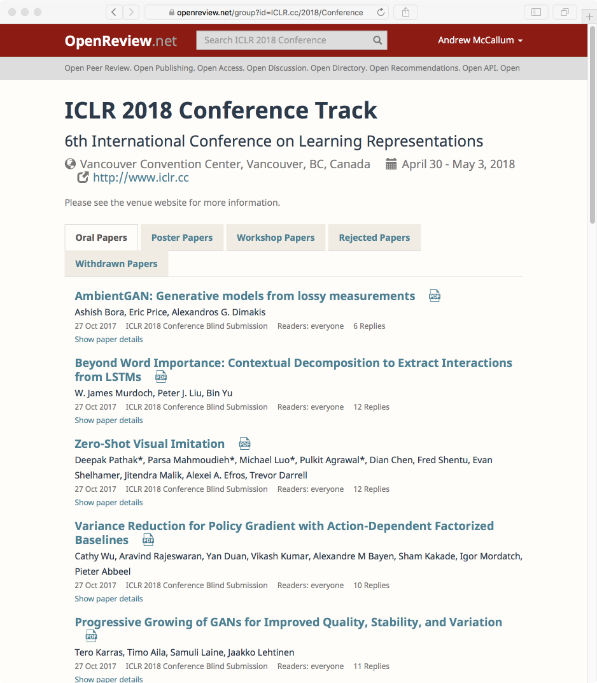

Slide 36
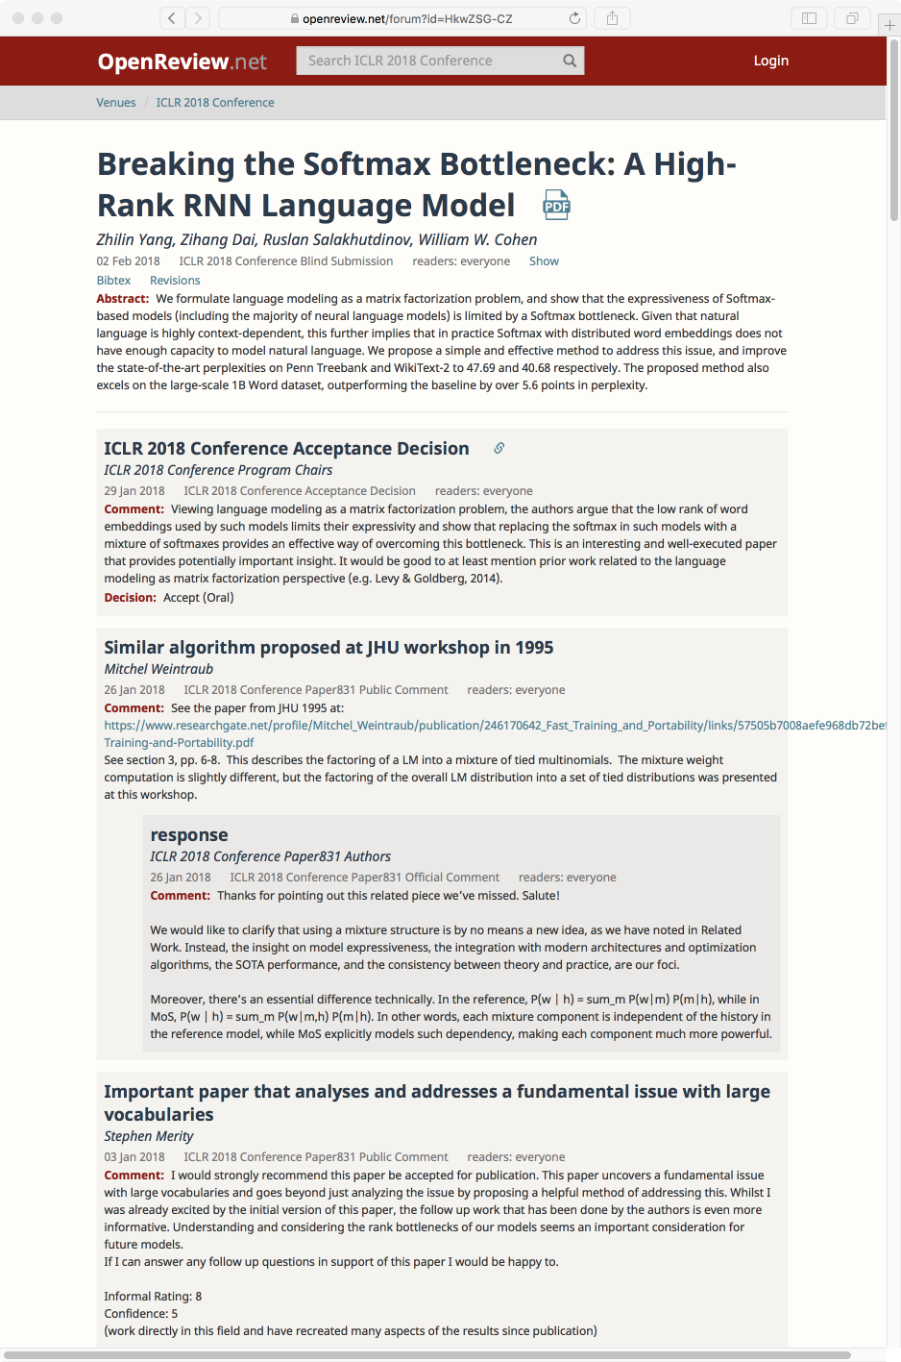
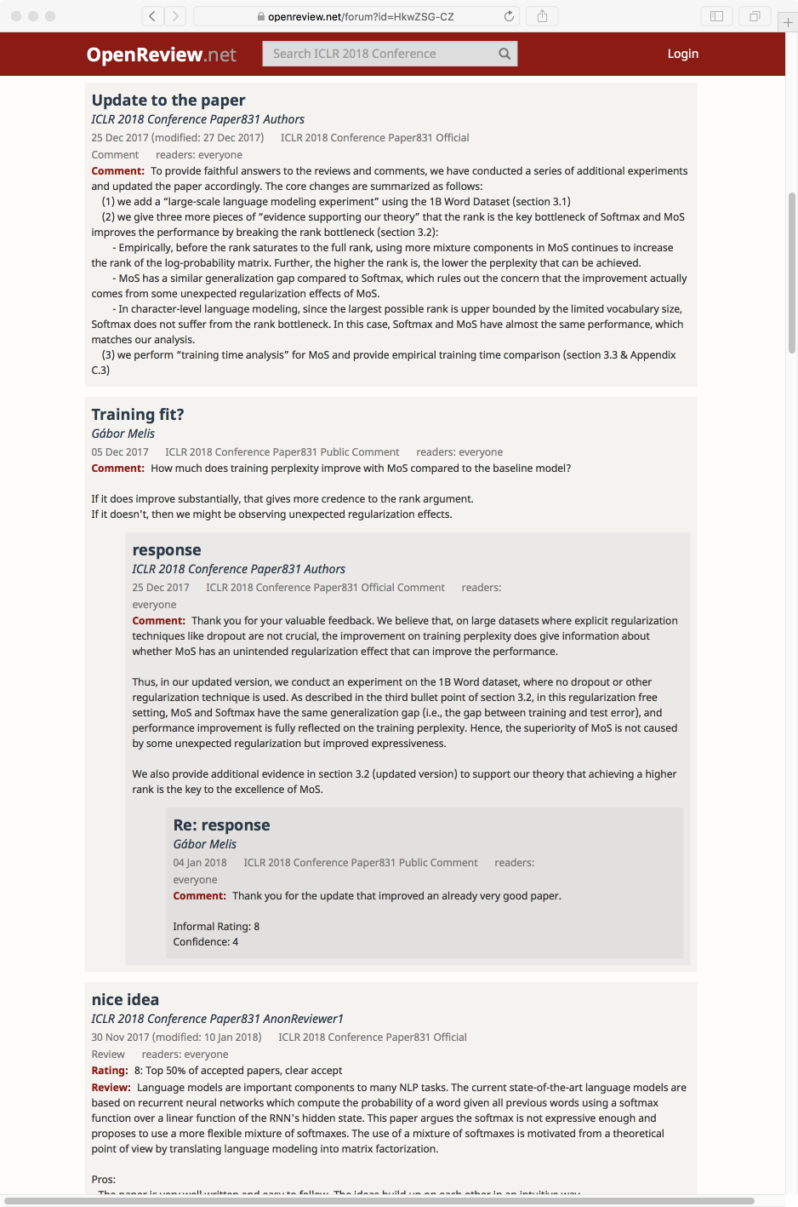
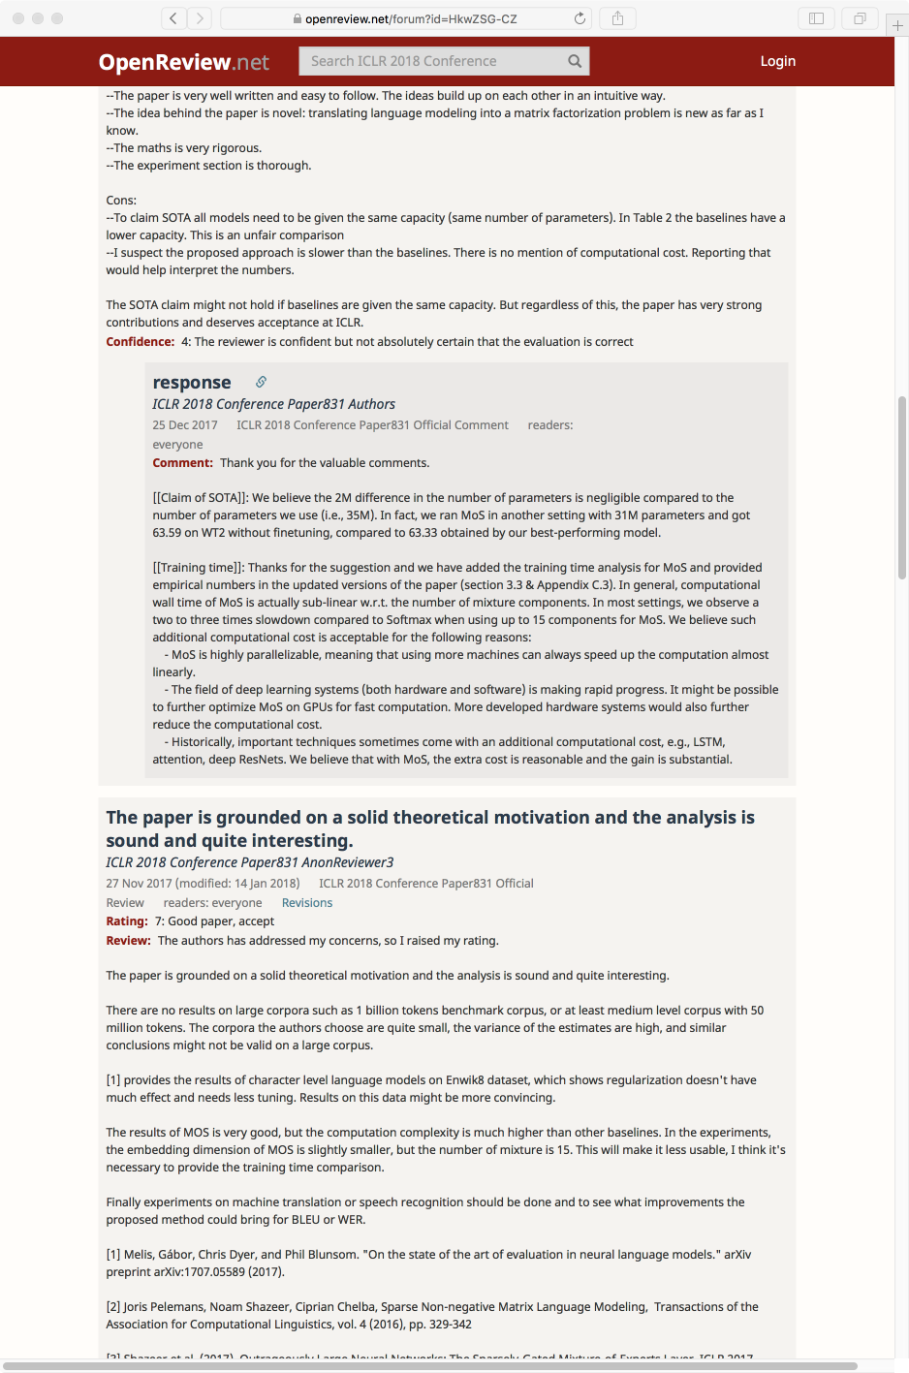
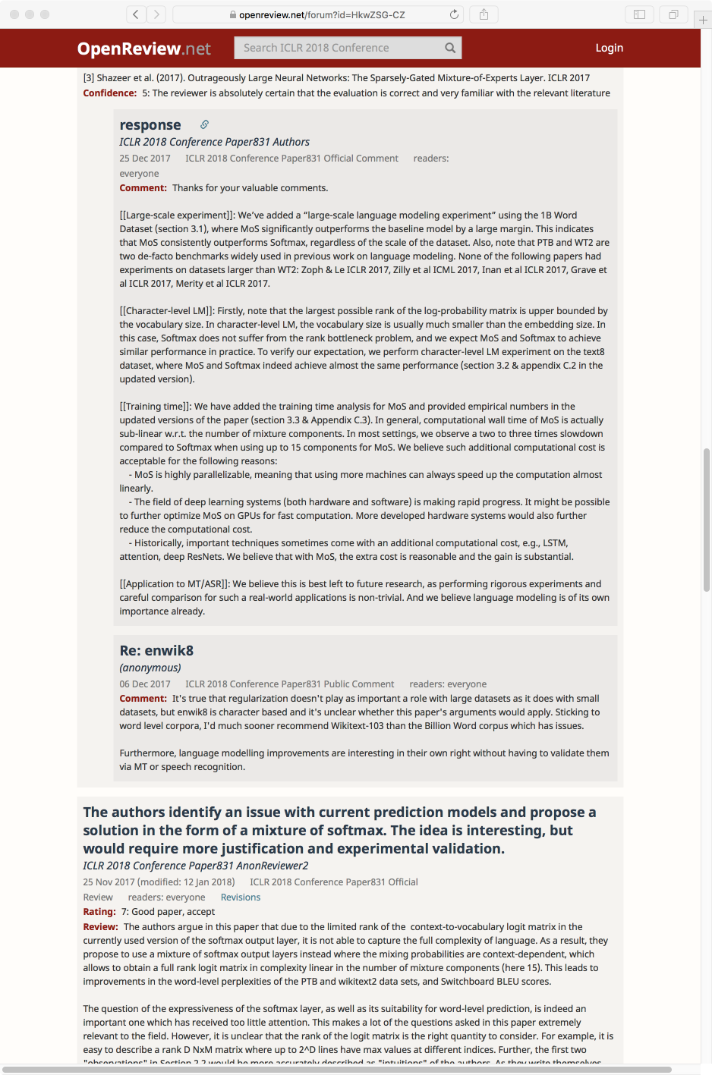
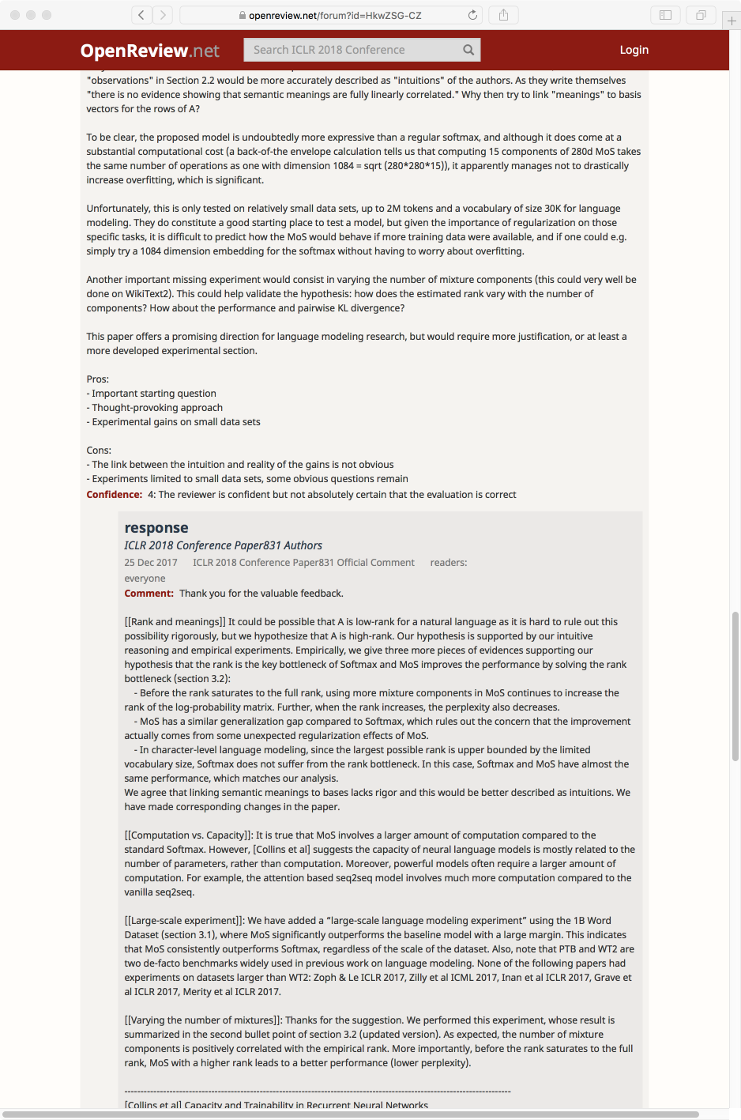
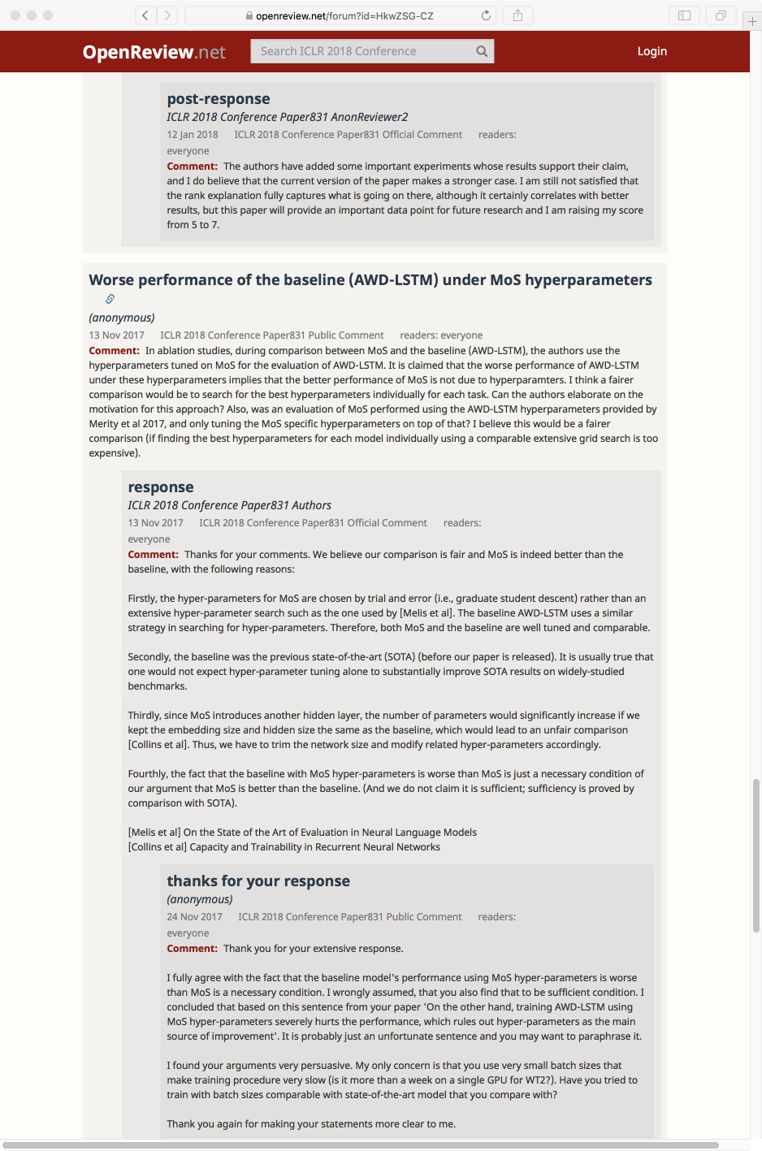
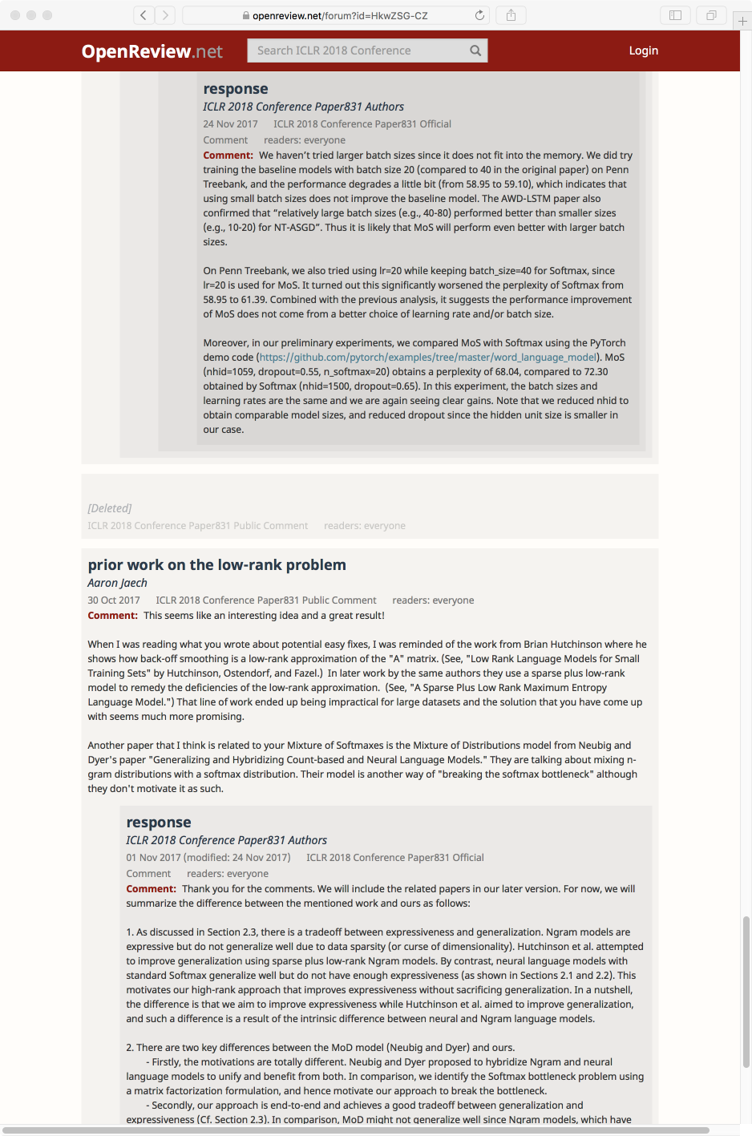
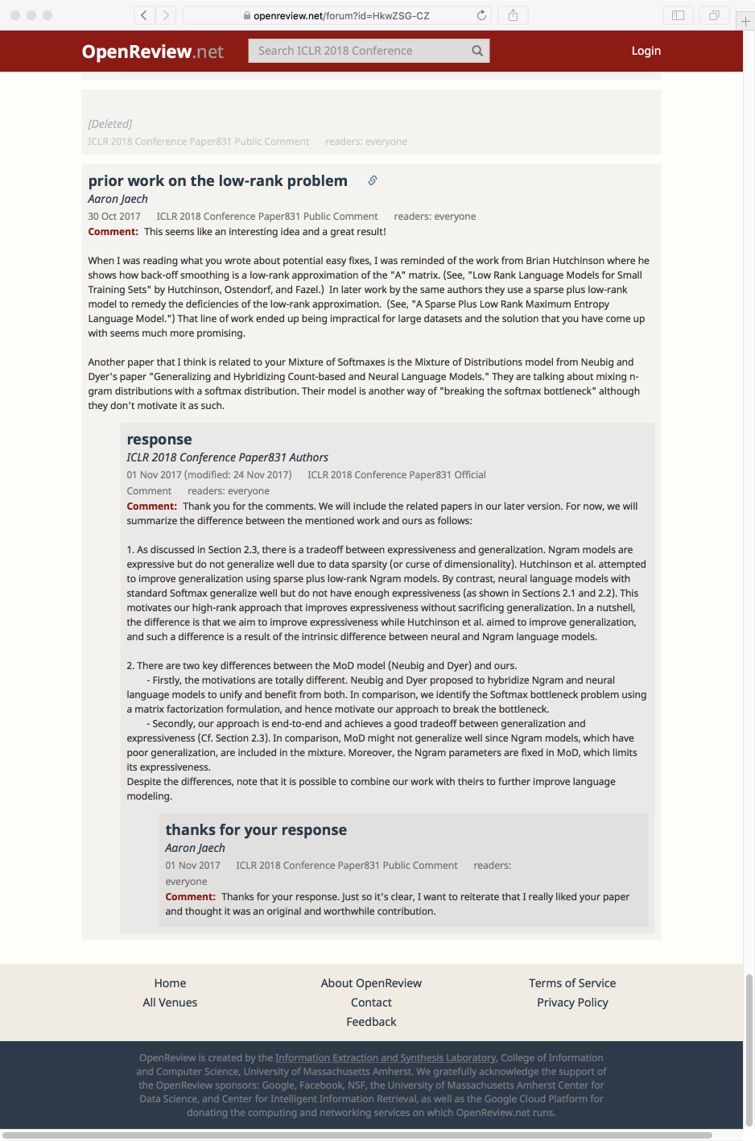

Slide 37
OpenReview.net Software Platform
Configurable
  small set of "Lego blocks" re-arrangeable
  for wide experimentation in closed...open review
  Basic objects: Groups, Notes, Invitations
  Scriptable API for defining workflow
Scalable
  Parallel-distributed backend DB technology.
  Soon mirroring all Cornell ArXiv + DBLP + ...
Open
  open publishing, open access, open discussion of papers, open directory of researchers and their expertise,
  open recommendation of reviewers to papers,...
  open API enabling others to build their own web front-end

Slide 38
OpenReview.net
Machine Learning Research
DB of researchers' expertise and conflicts,
auto-populated and maintained
  Using our research in information extraction, information integration, entity disambiguation, probabilistic reasoning about human edits...
Expertise-matching, papers to reviewers
  Using deep neural networks to build detailed topic models and interpretable, editable expertise models
  Using sub-modular optimization for many-many reviewer-paper matching at large scale for large conferences
Incentive system for review quality
  Mechanism design to encourage high-quality, unbiased reviews
  Large-scale analysis of sub-communities, sentiment, bias,...

Slide 39
Thank you!
Andrew McCallum
mccallum@cs.umass.edu

