Slide 1
Scientific Publishing in the Digital Age
Erin O’Shea
Howard Hughes Medical Institute
Workshop on peer review in the life sciences
Feb 7 2018

Slide 2
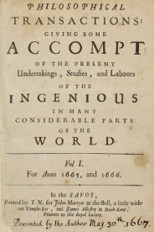
Purpose of scientific publishing
Publication of research findings
creates a public record of original scientific contributions,
gives authors intellectual credit for their claims,
enables others to re-use and build upon the findings in future research.

Slide 3
Challenges with scientific publishing today
  Corrupting incentives: scientists are evaluated based on where they publish, not what they publish.
  Lack of transparency and accountability: results of peer evaluation are not made available.
  Waste of resources and time: it takes on average 9 months to publish; and significant research funds are spent just on revisions.
  Limited access to research outputs: in general, scientists can only access research articles by paying fees.

Slide 4
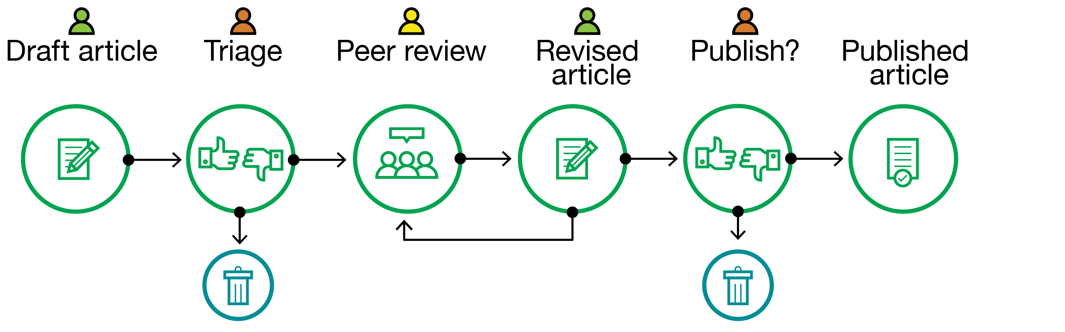

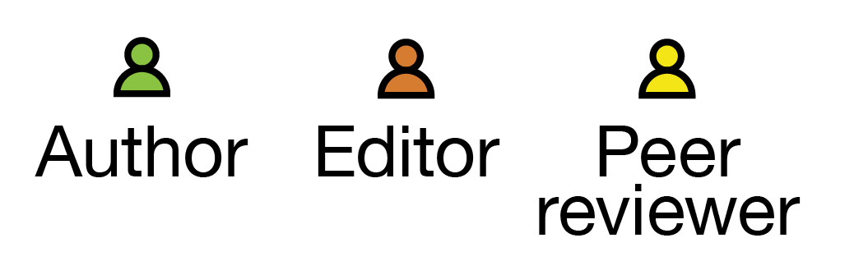
Current publishing process
2
4
3
1
1
Non-transparent peer review
2
Editor as gatekeeper
3
Journal-based metrics
4
Paywall: fees and subscription

Slide 5
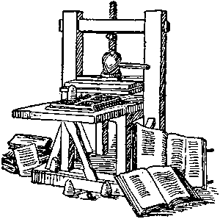

How we got here: Print!
The subscription model and editors as gatekeepers made sense when print distribution was necessary and expensive.
These limitations no longer apply, providing us with an opportunity to re-envision the role of editors, authors and reviewers and the subscription business model.

Slide 6
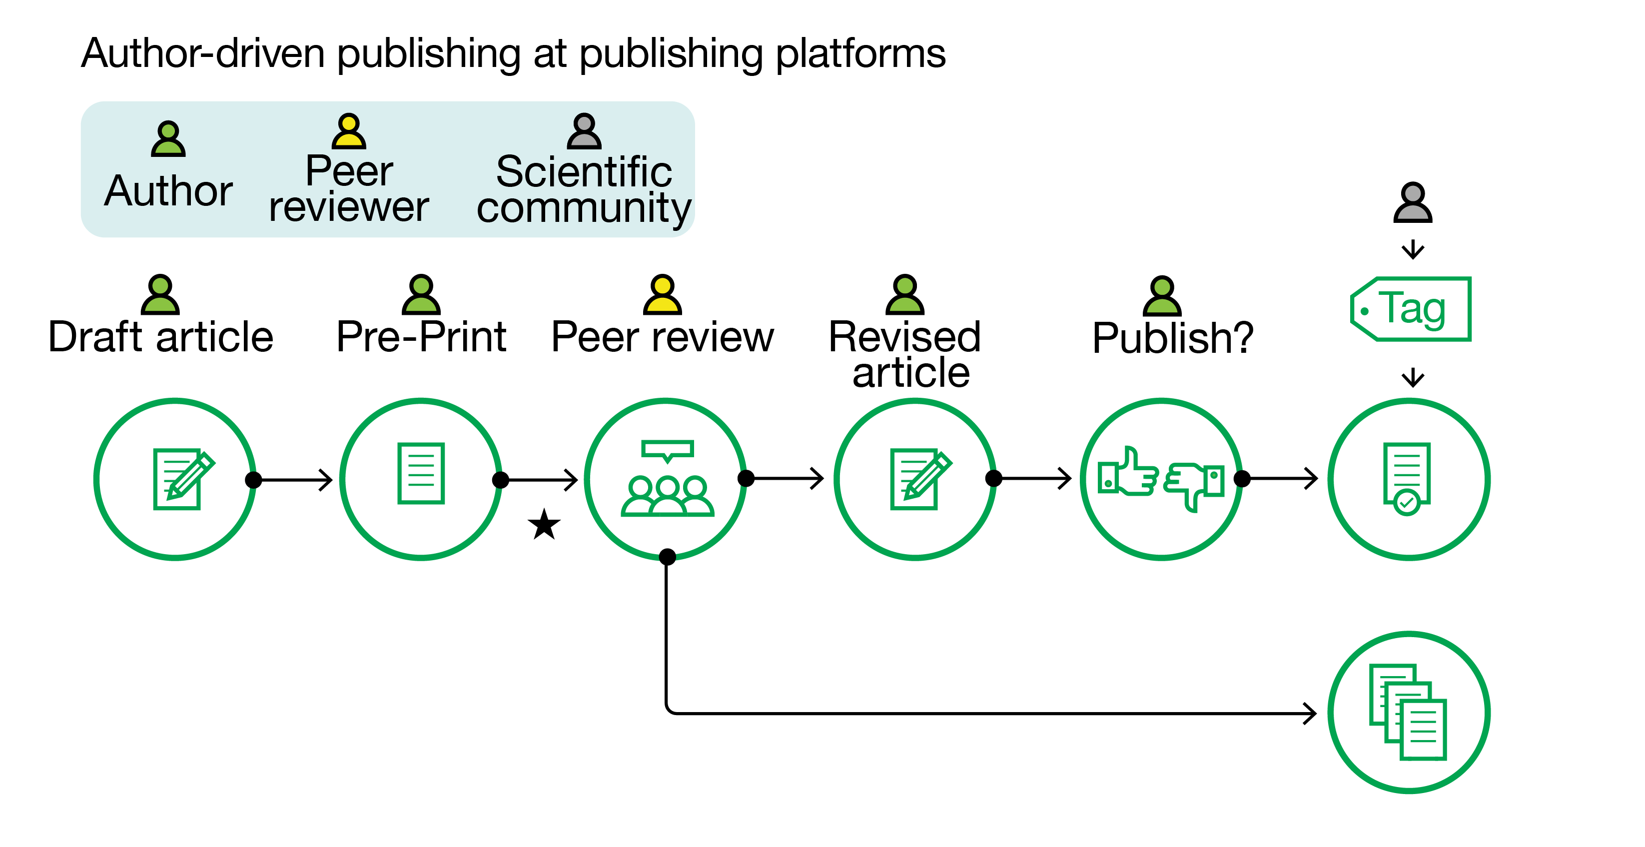
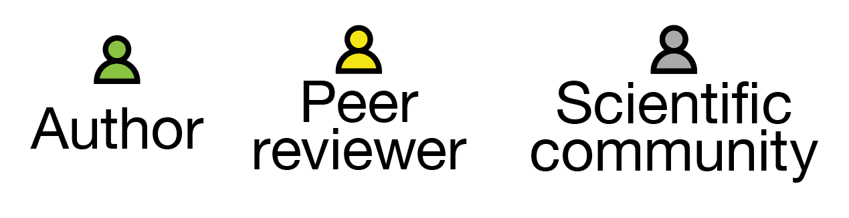
Proposed process
3
2
4
1
1
Open peer review
2
Author as publisher
3
Article-specific tags
4
Open Access

Slide 7
Evolving scientific publishing to address challenges
Lack of
transparency
Non-transparent peer review
Open peer review
Transparency Recognition
Resource waste
Publishing delay
Editor as publisher
Author as publisher
Timely sharing
Corrupting incentives
Journal - based metrics
Article - based metrics
Better aligned incentives
Paywall
Open Access
Free access
Limited access
8

Slide 8



The future….
Publication of
primary research
Curation of primary
research articles
Author-driven
Peer-improved
Open Access
Editor-driver
Community-driven
Fees Okay
Editors and journals less relevant; Publishing platforms more relevant
Journals shift from being publishers to curators
©2018 Howard Hughes Medical Institute
8

Slide 9
Feedback from you
Technology hurdle: what does it take to build online platforms that enable author-driven publishing and post-publication tags?
Cultural hurdle: what does it take for scientists and institutions to adopt and reward new publishing practices?
Financial hurdle: In an author-driven publishing model, the journal would publish more papers: would this step be sufficient to make the transition to Open Access financially sustainable?
Please give us your feedback on open peer review, author as publisher, post-publication tags at the workshop or via email: osheae@hhmi.org, sternb@hhmi.org, konfortib@hhmi.org

