Slide 1


Open Peer Review
@tonyR_H
Researcher Attitudes & Next Steps
ASAPbio/HHMI/Wellcome peer review meeting 8 Feb 2018
Tony Ross-Hellauer

Slide 2

“Open Peer Review” encompasses diverse constellations of many distinct aspects
** 122 definitions collected and analysed **
** 22 distinct configurations of 7 traits identified **
Open identities
Open reports
Open participation
Open interaction
Open pre-review manuscripts
Open final-version commenting
Open platforms
Primary
aspects
Secondary aspects
Image CC BY AC McCann, w/ amendment (by me)
See: Ross-Hellauer, 2017, "What is open peer review? A systematic review", F1000Research (DOI: 10.12688/f1000research.11369.2)

Slide 3
Survey on attitudes to OPR
Online survey for OpenAIRE project
Open Sept – Oct 2016
3062 complete responses from authors, reviewers and editors
Available: Ross-Hellauer T, Deppe A, Schmidt B (2017) Survey on open peer review: Attitudes and experience amongst editors, authors and reviewers. PLoS ONE 12(12): e0189311. https://doi.org/10.1371/journal.pone.0189311

Slide 7
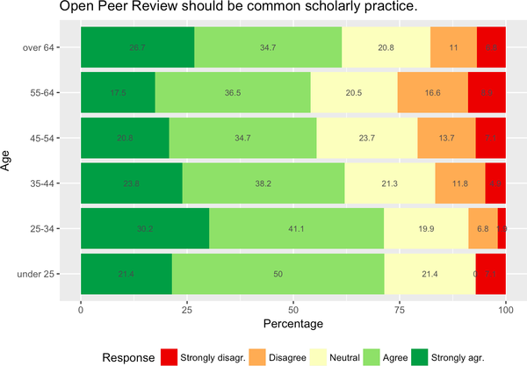
Views by age group

Slide 8
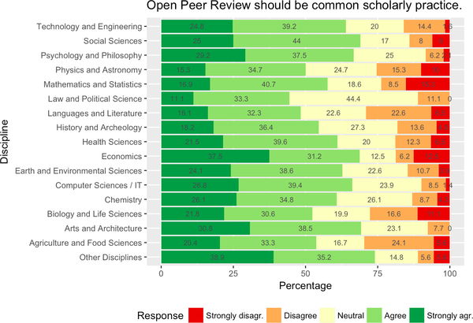
Views on OPR by scientific discipline

Slide 9
Attitudes to open peer review
OPR is already mainstream
  76.2% have practical experience
  60% believe OPR should be common practice
Positive reactions to most OPR traits (esp. open interaction, reports, participation)
However, pronounced rejection of open identities (51% against)
Generational differences – younger researchers more supportive
Diverse disciplinary differences need to be better understood

Slide 10
More research – what works, in which circumstances?
OPR is a very complex issue – what should be made open, in which circumstances, at what stage, to whom?
  “The large number of possible configurations of options presents a tool-kit for differing communities to construct open peer review systems that reflect their own needs, preferences and goals.” (Ross-Hellauer, 2017)
We need more evidence
  “[T]here is often little evidence to support or refute … claims [regarding OPR]” (Ross-Hellauer, 2017)
The way ahead
  Open up the data!
  Multi-stakeholder agreement on definitions and priorities for research
  Cross-publisher/-journal studies on what works and what doesn’t
  Upcoming workshop organised by OpenUP project – 27 March, London

Slide 11
Thanks!
Email: tross@know-center.at
Twitter: @tonyR_H
Many thanks to my co-authors on the survey Birgit Schmidt & Arvid Deppe
This work was funded by the European Commission H2020 project OpenAIRE2020 (Grant agreement: 643410, Call: H2020-EINFRA-2014-1).

