Slide 1
Post-publication evaluation through tags
Bodo Stern
Chief Development and Strategy Officer
HHMI
February 8, 2018

Slide 2

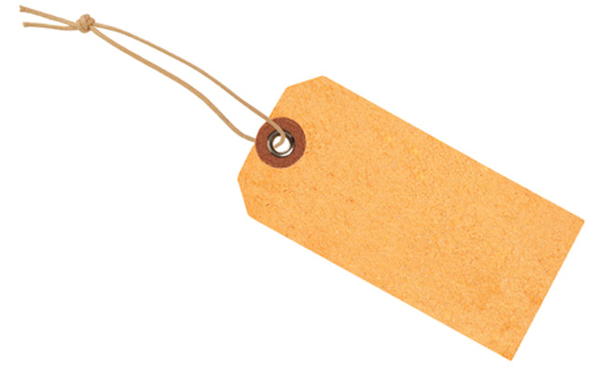
The problem: We need better indicators of scientific quality and impact
Journal-based indicators dominate today. They are simply not good enough because they evaluate scientists based on where they publish, not what they publish.
Technical
Quality
We need article-specific indicators that better reflect individual contributions. We refer to these indicators as ‘tags’ or ‘badges’.
Notes:
Slide 1: Talk about a conceptn the tagging of published articles. We have neither data nor concrete implementation plans. We would like to hear from you whether you think this concept is worth pursuing.
problem we are trying to solve: we need better indicators of scientific quality.
JIF;
We need article specific indicators; we refer to them as tags. It was pointed out in a comment to our white paper that the term ‘badges’ is more appropriate. Maybe the name will change; but I’ll call them tags for now since that’s what we called them in our written proposal.

Slide 3

Why do we need quality indicators?
Experts may not need indicators of quality and impact to evaluate articles or scientists in their own field. But we all rely on them to:
Select scholarly papers:
Indicators assist scientists in selecting relevant papers outside their field of expertise.
Evaluate scholarly applications:
Indicators assist scientists during the triage stage for funding or hiring decisions.
Notes:
Critiques from experts during the peer review process or after publication are and will remain the gold standard of scientific evaluations. That’s not what this presentation is about.
Experts may not need quick indicators to select or evaluate articles in their own field; you can find the papers in your field because you know the relevant players, you have keyword for searches etc.
But we all rely on them to navigate the vast published literature:
to find relevant papers outside our field of expertise.
to help in the evaluation of large numbers of scientists (triage steps in funding and hiring decisions; comparison of large groups of scientists).
End with: it is really useful to have genuine indicators of quality features.

Slide 4
post-publication tags
Tags are shorthand measures (‘proxies’) for a particular quality feature of published articles.
Citations
Critical features of tags
attached to article or easily discoverable
Easily generated, easily consumed
can change over time
Example tags
technical quality score
Reproducibility score
Citation score
Technical
Quality
Notes:
Read tag definition.
If we want these tags to be effective as article-specific indicators they need to fulfill a few criteria:
to be either attached to the paper or at least easily discoverable with the paper.
easily generated and easily consumed. The impact factor is so powerful because it is an easy number to remember (lodged into scientists’ brains). Article specific tags may never be as simple as the impact factor but hopefully they would also not be nearly as flawed, considering that they are article-specific. Goal: as simple as possible while genuinely reflecting the feature of the article they are meant to represent;
change over time to respond to the changing impact of a paper. This allows papers to rise and fall in impact over time tracking how useful they are for the scientific community.
Example tags: the community and journals could experiment with a variety of tags – we can then figure out which tags are most useful
Technical quality could display a score for technical quality;
Reproducibility tag could capture contributions from scientists who were able or not able to reproduce the findings in the paper.
Citation tags could capture the citation history of a paper, ideally not absolute citation number but relative to the average citation number in the particular field.
Features:

Slide 5
Feedback
Do you think tags would be a good and feasible alternative to journal-based indicators? Or can you think of better approaches that allow scientists to quickly identify a desired value of articles?
Technological hurdles:
How can tags be created?
how can tags be ‘attached’ to papers?
How can tags change over time?

