Slide 1

Preprint Town Hall for Scientific Societies
Ron Vale, UCSF/HHMI
Former President of ASCB
Cynthia Wolberger, Johns Hopkins University
Chair, RCSB Protein Data Bank Advisory Committee
Jessica Polka, Exec. Director ASAPbio
Co-Founder of COMPASS Committee, ASCB

Slide 2
Two Important Roles of Scientific Societies
1. The exchange of scientific information prior to publication.
2. Promoting the careers of young scientists

Slide 3
A Key Problem to Address
Time to First
NIH R01 Funding in the US
1980
2013
35.7 years
42.1 years

Slide 4
R01
Publication
Publications are critical for career advancement
Job
Publication
Postdoc
Publication
Graduate Student

Slide 5
Scientific journal publications from UCSF graduate students
Graduation
Time
Time to First
Author Pub
Number
First Author
Pubs
1979-1989
5.7 yr
4.7 yr
2.2
2012-2014
6.3 yr
6.0 yr
1.4
Vale, PNAS 2015

Slide 6
Consequences:
1) Slow Dissemination of Research Results
Information is being held within laboratories for longer periods of time.
Less unpublished information is being shared at national meetings
2) Longer Training for Students and Postdocs
3) More worry and a loss of the joy of scholarly communication

Slide 7
Key Message:
Preprints and Peer Review Publication

Slide 8
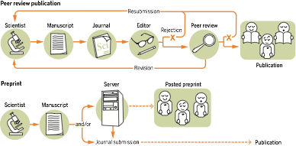
Preprints and Journals
Can Work Together and Have Complimentary Strengths
Science Magazine May 20, 2016
Disclosure and
Rapid Dissemination
Validation through
Peer Review
T

Slide 9
Why Preprints?
Feasible on a near term time scale (there is a 25 year history with arXiv)
2) Addresses many (but not all) current issues that need solutions. Allows possible innovations.
3) Operates on a large scale and low cost
(thousands of papers for ~$10-30/paper)
4) Is a dissemination mechanism that is scientist-controlled and potentially amenable to governance by the scientific community.

Slide 10
Preprints in biology: Learning from a quarter-century of experience in physics (and a few other fields)
Cynthia Wolberger, Ph.D.
Professor of Biophysics and Biophysical Chemistry
Johns Hopkins University School of Medicine

Slide 11
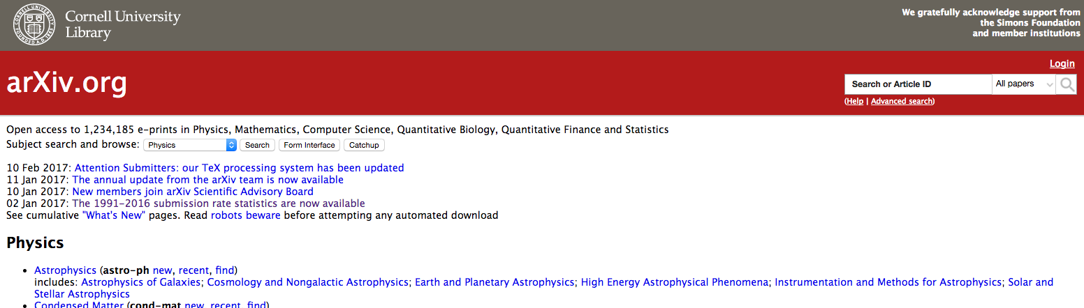
Preprints: New to biologists, old hat to physicists
For most physicists and mathematicians, a scholarly publication begins with an electronic preprint.
Arxiv: Electronic preprint server established in 1991 by Paul Ginsparg.
1,234,185
as of Feb. 20, 2017

Slide 12
Growth of the Arxiv 1991 - 2016
Annual depositions by field
Finance, biology, statistics
computer science
physics
mathematics
physics
>110,000 depositions/yr
>1,234,000 preprints
https://arxiv.org/help/stats/2016_by_area/

Slide 13
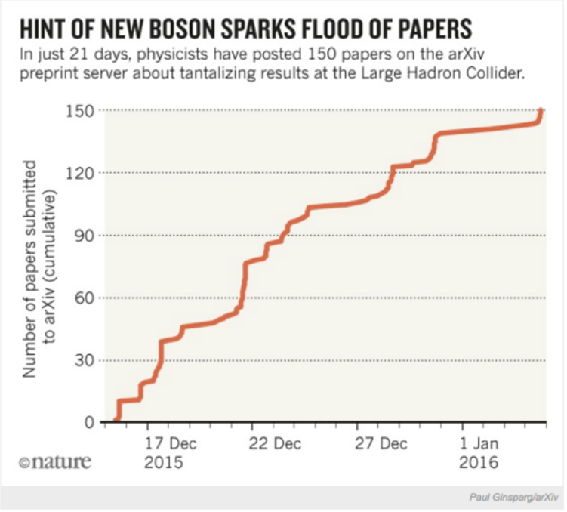
How preprints are used in physics, math
Early communication of results.
Get feedback prior to publication.
Accelerates the pace of discovery
Democratic – available to all, not just e.g. attendees at small, $$$ conferences where unpublished results are presented.
Reaches more people

Slide 14
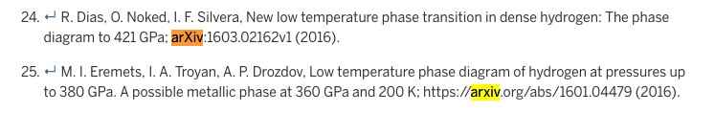
How preprints are used in physics, math
Establishes priority (have time stamp, permanent identifier)
(what if Virginius Siksnys had posted a preprint on CRIPSR-Cas9 editing….)
Evidence of progress in:
Grant applications, progress reports (NSF)
Hiring and promotion CVs (separate section for preprints)
Postdoctoral applications
Citeable: e.g. from physics paper, Science, Feb. 17, 2017 issue

Slide 15
Preprints and journals
Preprints and peer-reviewed journal coexist in physics, math, computer science.
Most preprints end up in peer-reviewed journals, others in conference proceedings, theses.
High-energy physics, 2004-2014:
>80% of preprints have journal citation.

Slide 16
Do preprints increase risk of junk publications?
All preprints pre-screened before posting.
Reputation is at stake if you post junk or MPUs*.
Supposition is that people READ preprints, don’t just cite because they are there.
Reward is for contents of preprint.
Community knows they are not peer-reviewed.
* Minimal Publishable Units
Image: http://newjerseycashforcars.com

Slide 17
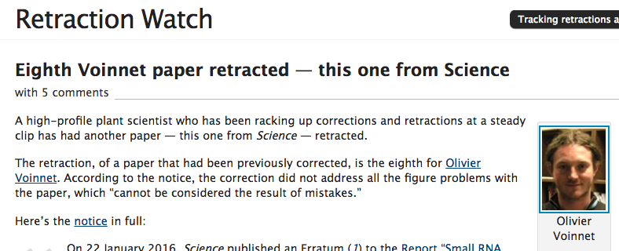
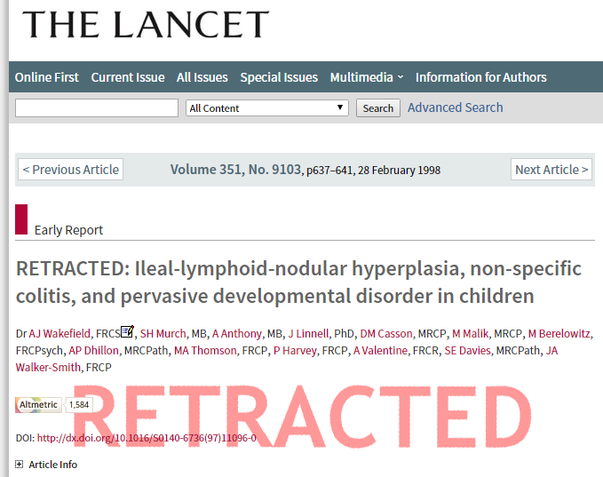
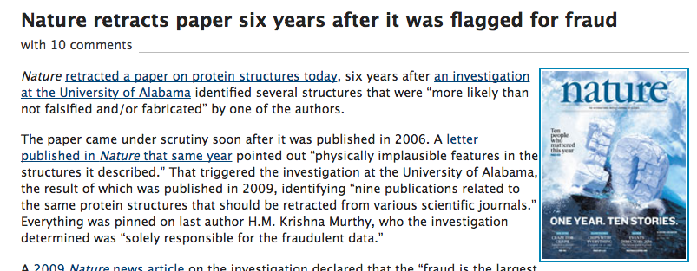
Do journals increase the risk of junk publications?

Slide 18
Are biologists different from physicists?
No.
Far more similarities than differences.
We, too, can benefit from:
More rapid communication.
Opportunities to show progress
Pre-publication feedback.
Emphasis on contents rather than where it is published
Peer review will survive in biological sciences as in physics, math, etc.

Slide 19
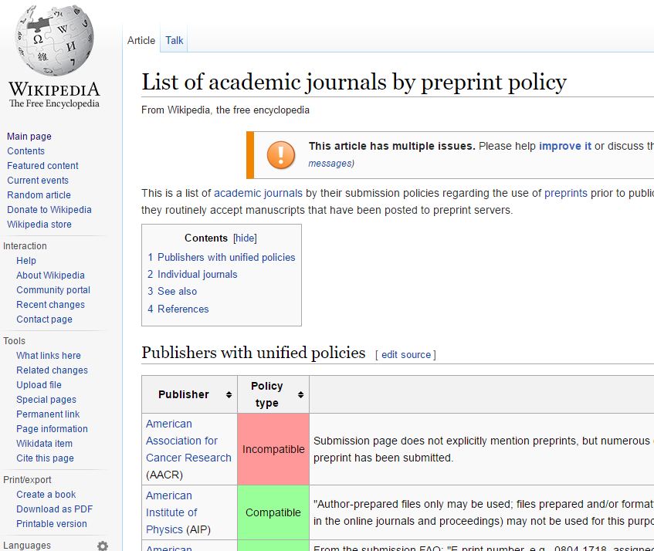
# of preprint-friendly journals large and growing
Nature and Nature journals,
Science,
PNAS,
Cell,
eLife,
J. Cell Biology,
EMBO,
ASM journals
Oxford Press journals,
J. Biol. Chemistry
MBoC
Genetics
J. Neuroscience
…….

Slide 20
ASAPbio & the central service

Slide 21

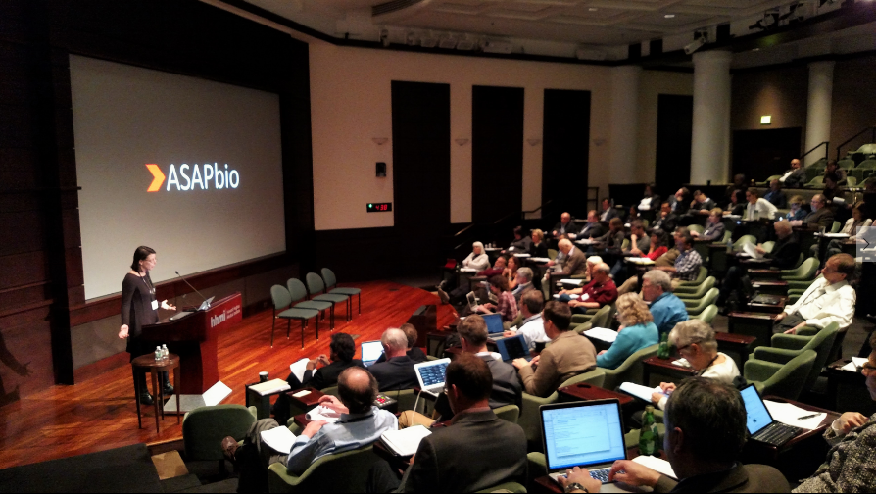
Accelerating Science and Publication in biology
Feb. 16/17, 2016 at HHMI Headquarters
Strong consensus that broader use of preprints could become a valuable addition to the journal system

Slide 22


.org
Moving preprints forward
Funding
Agencies
Scientists & Societies
University
Promotion
Committees
Journals

Slide 23
How should preprints work?
Discoverable
Stably preserved
Agreed-upon standards
Available for innovative reuse
Governed by the community

Slide 24



Preprints in biology are fragmented

Slide 25
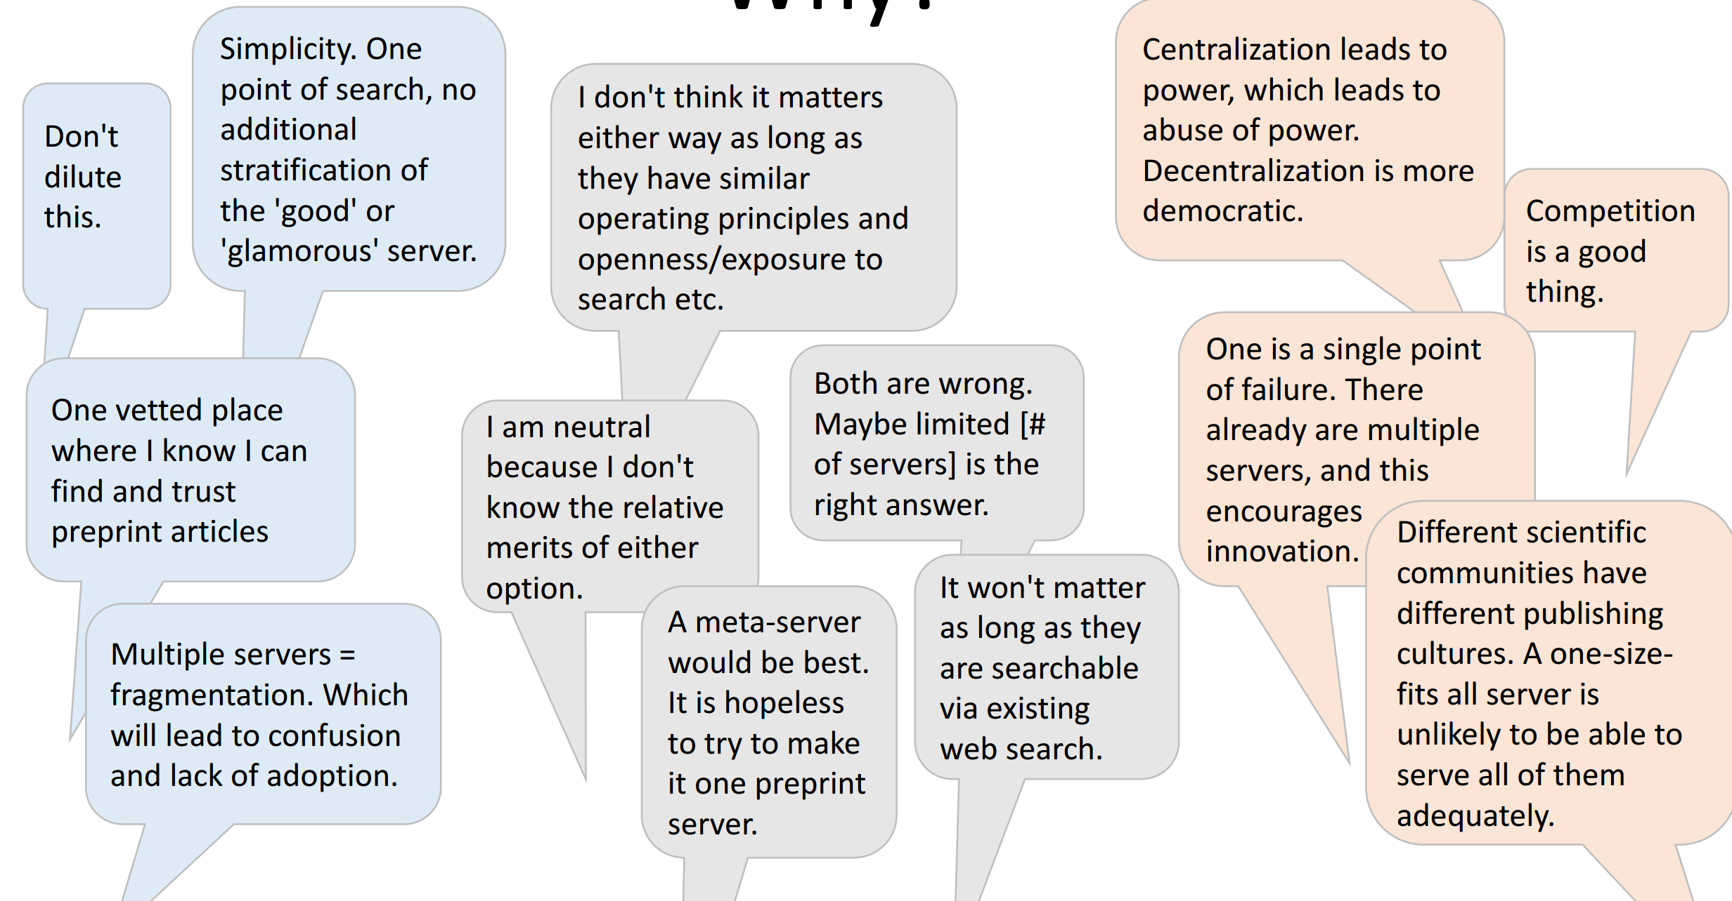
Is it better to have one or many servers?
http://asapbio.org/wp-content/uploads/2016/05/Preprint-server-preferences-survey.pdf

Slide 26
Developing the idea of a “central service”
Funder’s workshop (May 24, 2016)
Consultations (summer 2016)
Technical workshop (August 30, 2016)
RFA & funder principles release (Feb 13, 2017)

Slide 27













Central service
Common, community-governed database
Search
Text mining
Annotation
Discussion

Slide 28
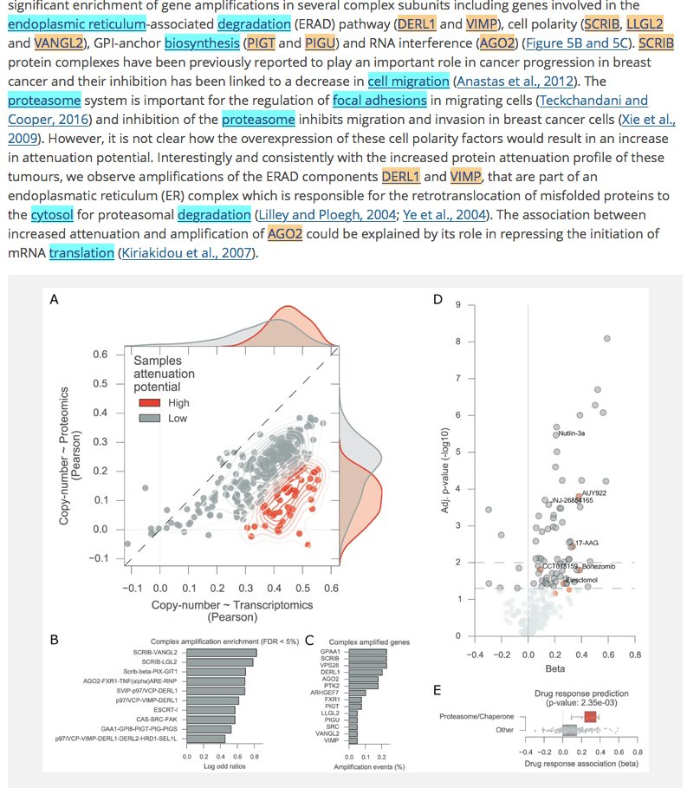
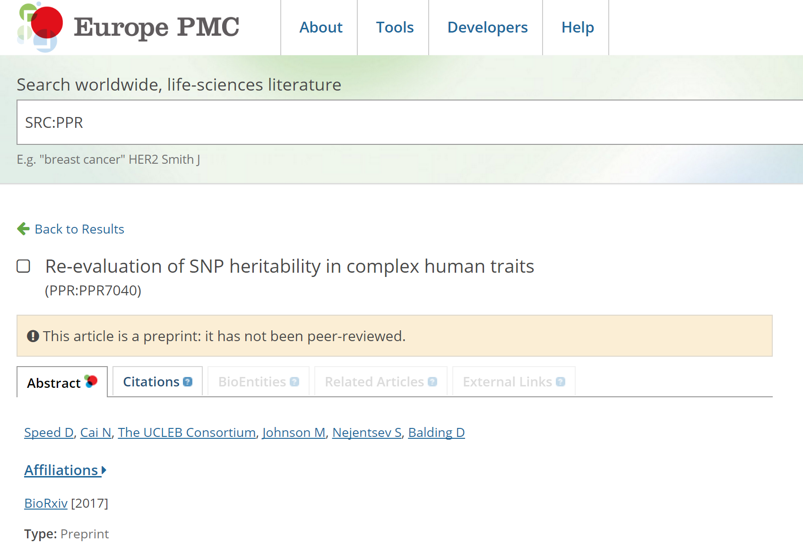
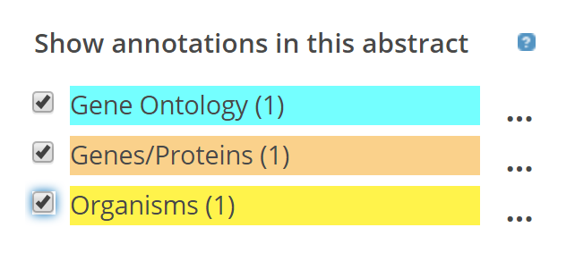
Annotation
BioRxiv preprints on Europe PMC with SciLite annotations
tinyurl.com/jufufjn

Slide 29
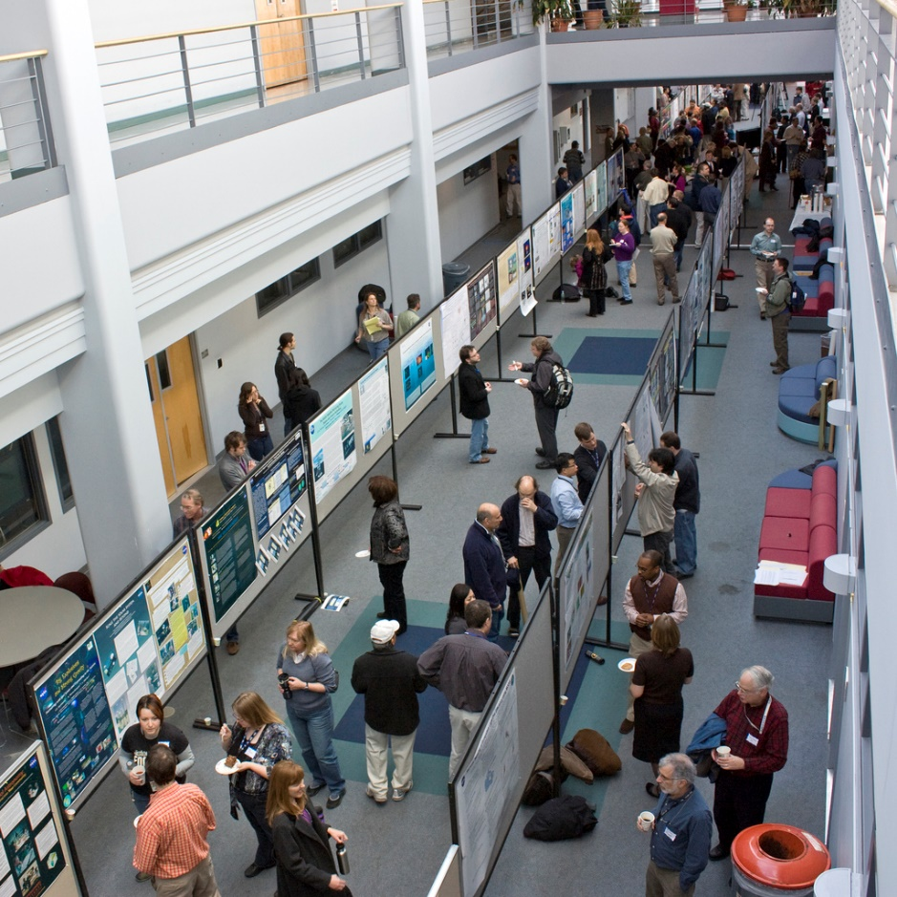
Discussion
Flickr/NASA Goddard

Slide 30
Functions of a Central Service
Function as a search engine (like PubMed)
Aggregate full text of content
Preserve content
Facilitate reuse w/ download & APIs (text mining & machine access)
Provide open-source software tools
Convert manuscripts to HTML
Screen manuscripts
Standards set by a scientist-led governance body
asapbio.org/rfa

Slide 31
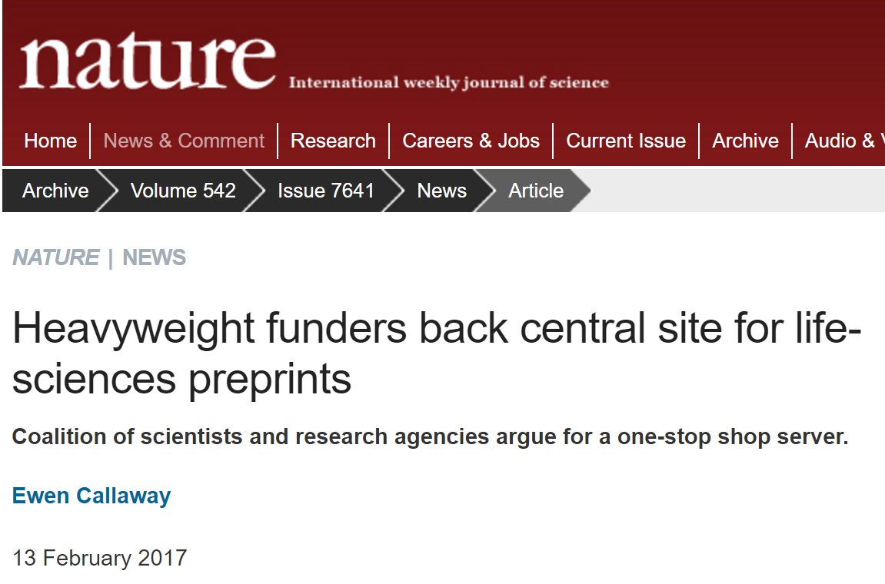
asapbio.org/principles
asapbio.org/asapbio-newsletter-vol-7

Slide 32

asapbio.org/feb23

