Slide 1



Jessica Polka
Ron Vale
Bodo Stern
Boyana Konforti
Robert Kiley
Transparency, Recognition, and Innovation in Peer Review in the Life Sciences

Slide 2
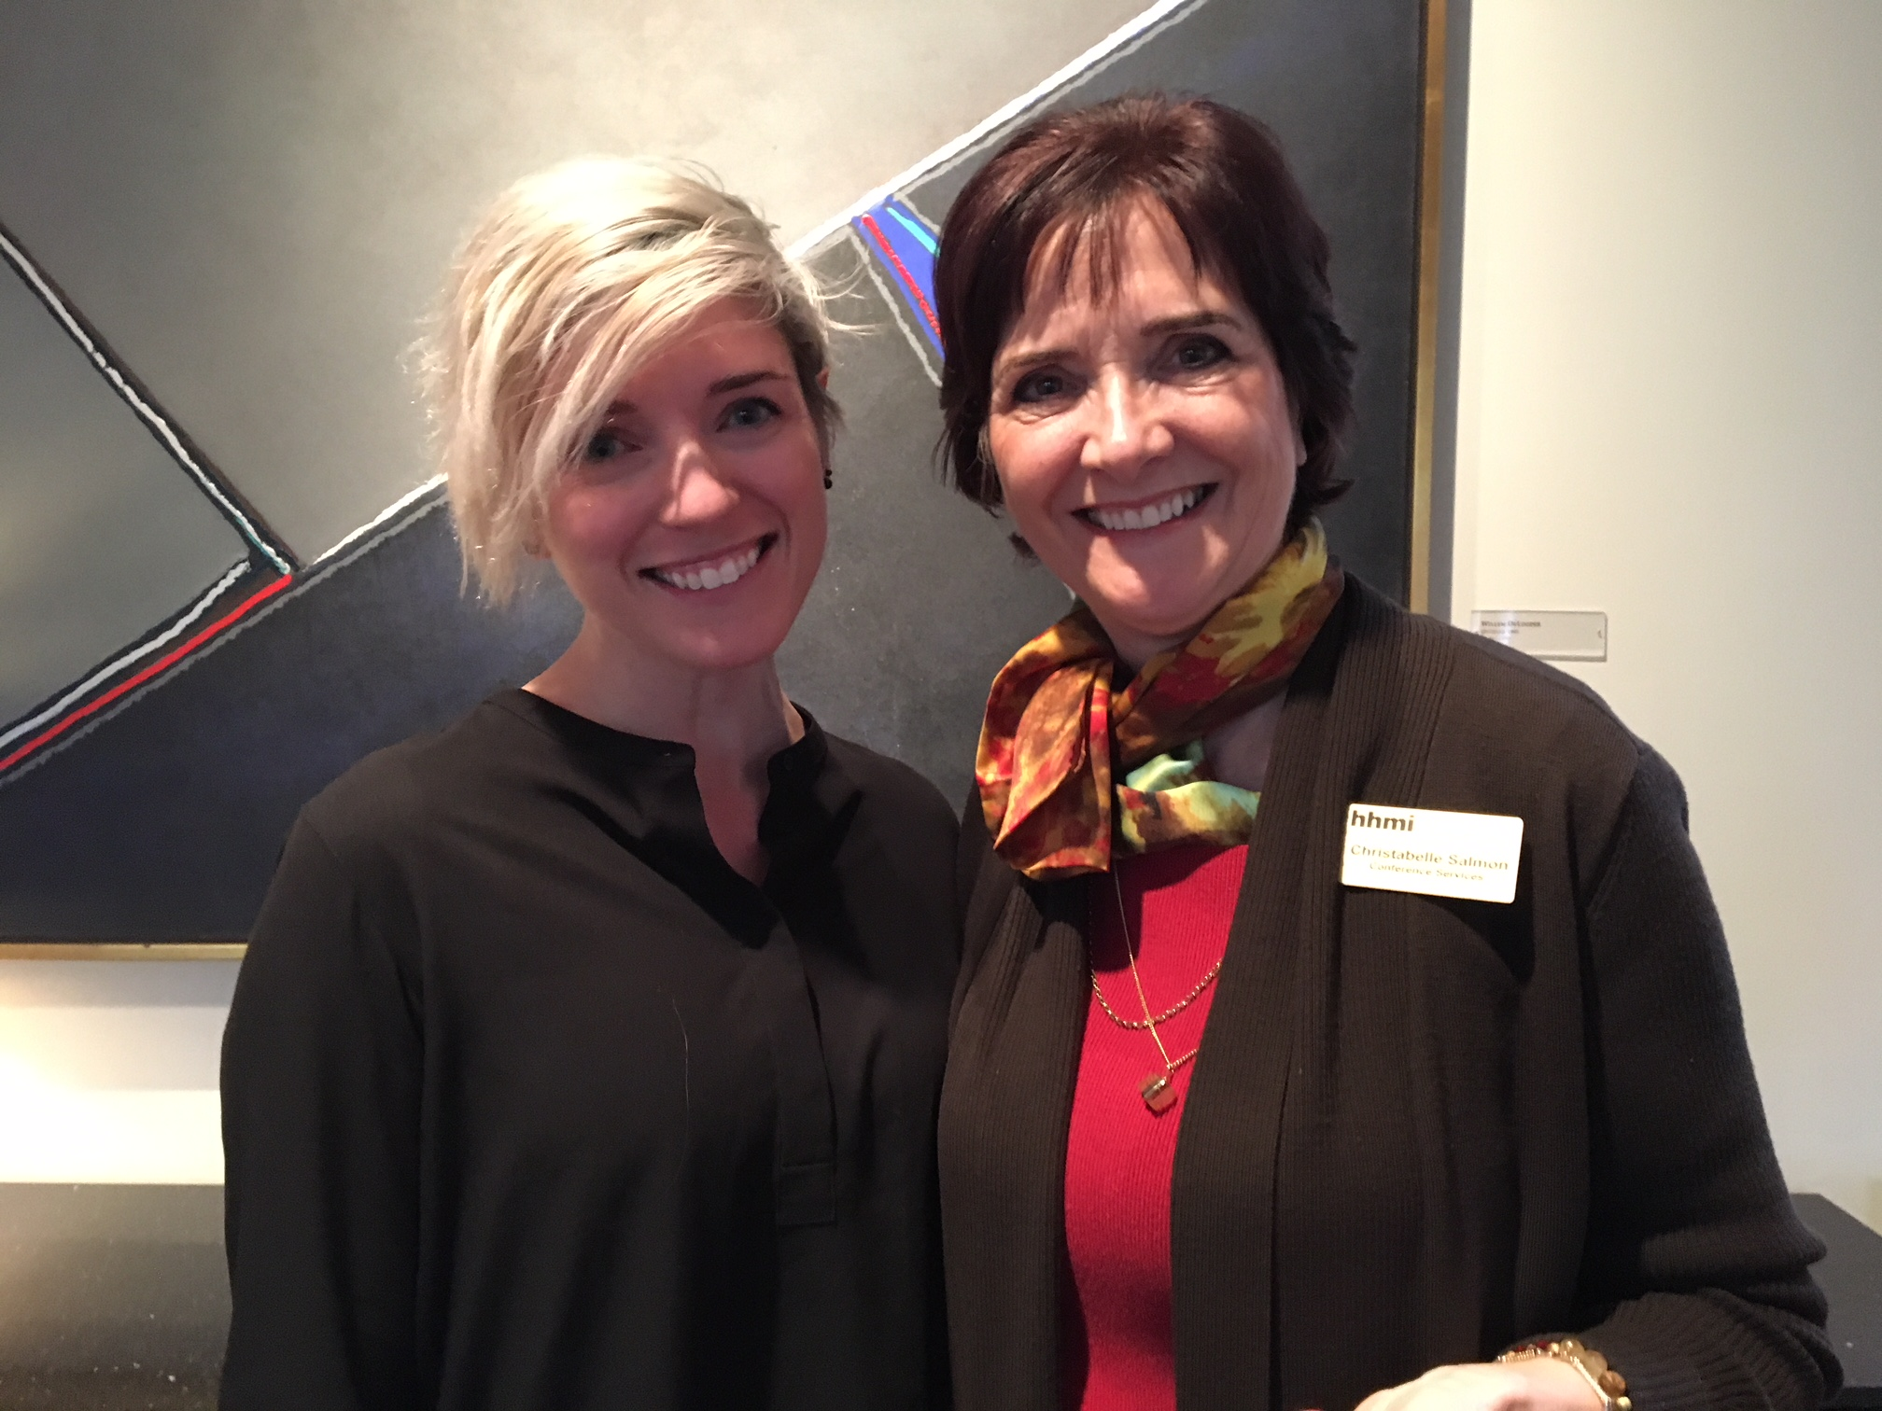
Jessica
Polka
Christabelle
Salmon

Slide 3
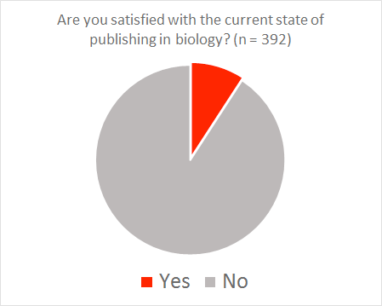
ASAPbio
poll 2016
9%
91%
J

Slide 4
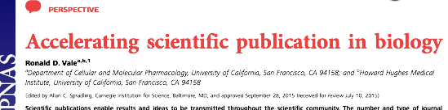
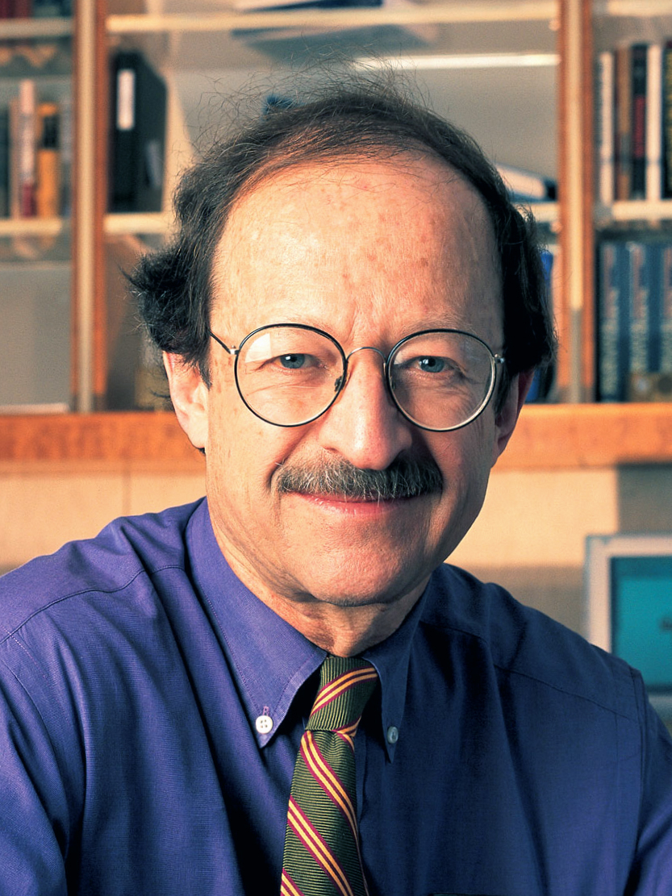
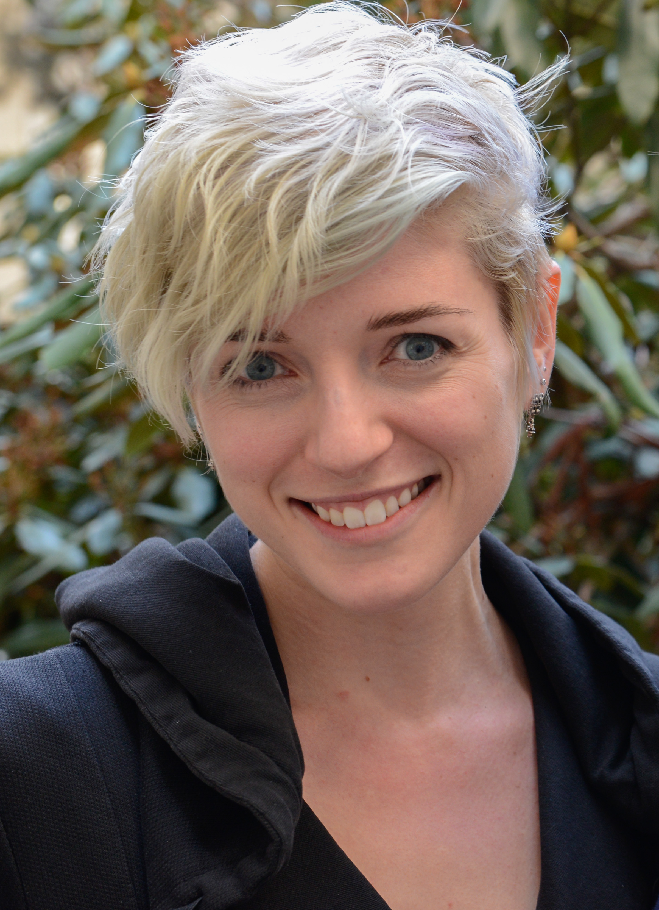

Harold Varmus
Jessica Polka
Daniel Colón-Ramos

Slide 5
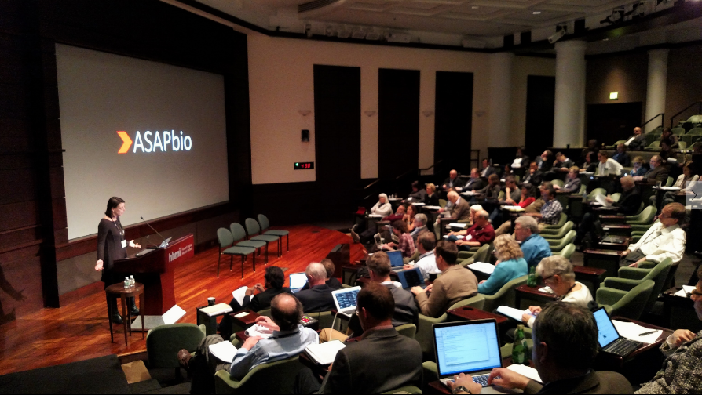
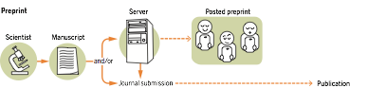
Disclosure and
Rapid Dissemination
Validation through
Peer Review

Slide 6
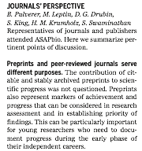

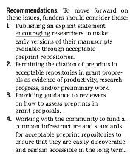
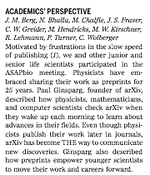

Slide 7
Data by Jordan Anaya, prepubmed.org

Slide 8








preprint policies
Simons Foundation
preprint policy
indexes preprints
preprint policy
web site
preprint policy
supports bioRxiv
preprint meeting
Data by Jordan Anaya, prepubmed.org

Slide 9
ASAPbio.org/peer-review

Slide 11
Transparency and Recognition
in Peer Review
Thursday Morning:

Slide 12
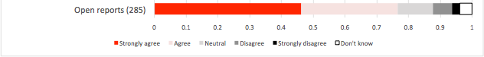
Should Peer Review Become More Transparent?
Open Reports
Only 2.2% of Life Science Journals
make their peer review reports accessible
European Commission Open Science Monitor 2017

Slide 13
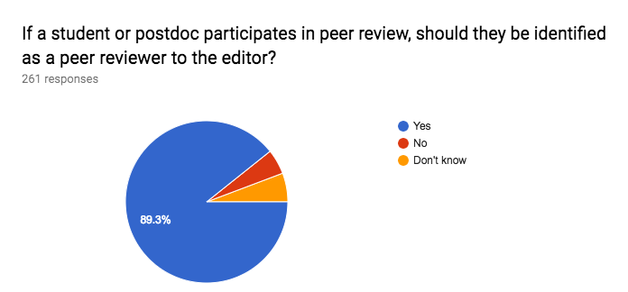
eLife Survey, Jan 2017
To what extent was your supervisor involved in your peer review?

Slide 14
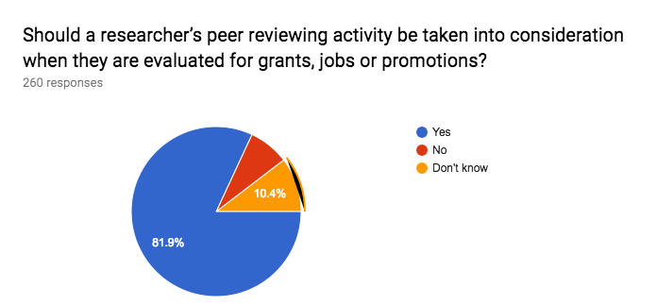
Should peer reviewing be recognized?

Slide 15
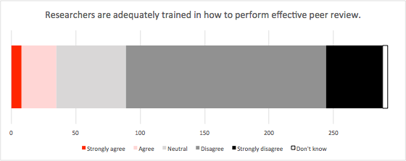
Do we need better training in peer review?

Slide 16
What experiments could be
tried in peer review?
Thurs Afternoon:

Slide 17
Friday Morning:
The “Unconference”
asapbio.org/peer-review

Slide 18
Jessica Polka
Ron Vale
Bodo Stern
Boyana Konforti
Robert Kiley
Transparency, Recognition, and Innovation in Peer Review in the Life Sciences

