Slide 1


Slide 2
Peer Feedback
Ideal
Practical
More important than technology:
Understanding the Culture and Behavior
of the Scientific Community
Breaking down a Complex Problem into Components

Slide 3
Preprints
Journal Article
Disclosure of Work
Evaluation
Preprint Server
Journals
Scientist-Driven
Disclosure
Evaluation,
Ethical/Data Checks

Slide 4
Unpacking Peer Review
Technical Merit/
Improving Work
Journal Suitability/
Ethical/Data Checks
Scientists/
Scientific Societies
Journals
Curation,
Ethical/Data Checks,
added features
Technical Merit/
Improving Work

Slide 5
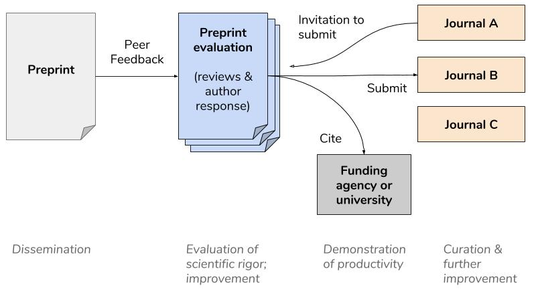
Peer Feedback
Journal Agnostic, Assigned Peer Review
Improving work
Better and more efficient entry point

Slide 6
Why review before journal submission?
“Authors send papers before they are ‘ready’ to be published. I spend a lot of time training researchers in the art of writing a biomedical research manuscript and strongly believe in the benefit of feedback.”
Vivian Siegel, 2008;
Disease Models and Mechanisms
“I believe our best hope for fair and constructive decisions is to relieve reviewers of the responsibility to make recommendations for or against publication and to maintain a separate, much smaller pool of editors who can be dedicated to the journal and to its standards. This would of course require editors to take responsibility for
their decisions and not to hide behind the recommendations of anonymous reviewers.”

Slide 7
Author Choice

Slide 8
What are the benefits?
Peer review as service to improve scientific work rather than serving a “gate keeper” role
A flexible pipeline with author-choice of final publication venue
Potential of better match making with journals and
faster acceptance
Informing the evaluation of preprints and more preprint acceptance
New roles for scientific societies as organizing structures for peer review

Slide 9
What are the hurdles?
Us-
Do scientists want to support a
scientist-driven peer review model?
Credibility-
Can we get excellent scientists, funding agencies,
and leading scientific societies to participate?
Creating value-
Peer review as a service means delivering excellence
Integration with Journals-
Would a critical number of journals be willing to partner?

Slide 10
Peer Feedback
Creating a Community
Individuals and organizations
partnering for the common good

